Slide 1



Making RPM Work:​
Launching, Growing & Optimizing RPM
6/5/2025
12-1PM
Notes:
Title Slide Option 2

Slide 2

Housekeeping
Welcome!
Let’s get to know each other - Take a moment to introduce yourself in the chat!
Please change your name to your full First and Last Name
Please add your Health Center/Organization Name next to your name!
Portions of this initiative are supported by the Health Resources and Services Administration (HRSA) of the U.S. Department of Health and Human Services (HHS) as part of an award to CHCANYS’ New York State Primary Care Association (NYS-PCA) totaling $1,932,890. The contents are those of the author(s) and do not necessarily represent the official views of, nor an endorsement, by HRSA, HHS, or the U.S. Government. For more information, please visit HRSA.gov

Slide 3




Making RPM Work:
Launching, Growing & Optimizing RPM
Thursday, June 5, 2025
Christian Milaster ∙ Founder & CEO

Slide 4
The Promise
Getting started with RPM: People, Process, and Technology
The effective management of chronic diseases is at the core of population health programs and value-based care arrangements.
To help patients manage their chronic conditions, one highly effective tool is Remote Physiological Monitoring (RPM).
This presentation will provide pragmatic guidance on
• developing your RPM strategy
• using RPM for chronic care management (CCM)
• using RPM to reduce avoidable utilization (e.g., readmissions)
• the people and processes of RPM
• RPM technology options
• reimbursement for RPM and CCM

Slide 5
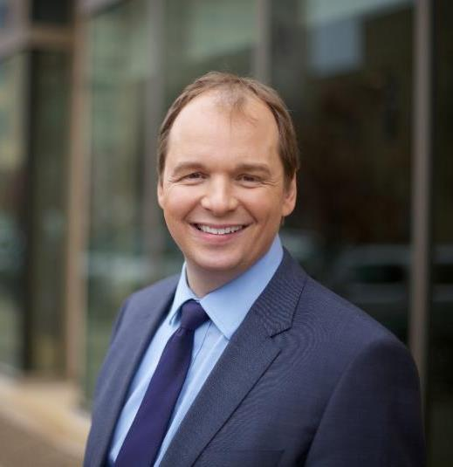








About Christian Milaster
35+ years
Pinc
Soft
“Optimizing
Service Delivery”
In Telehealth
since 2003
Video Visit Implementations
since 2008
In Rural Health, Behavioral Health
since 2012

Slide 6

Making RPM Work
CHCANYS Webinar Series
✅Thursday, May 29 – People, Processes, and Technology
➡️Thursday, June 5 – Launching, Optimizing, and Growing RPM
📅Thursday, June 12 – Billing, Coding, and Reimbursement,

Slide 7

RPM Recap

Slide 8
RPM Definition
“Everybody agreed until somebody defined it.”
Remote Patient Monitoring
Remote Physiological Monitoring
The continuous or periodic
collection, transmission and review
of physiological data
to inform care decisions.

Slide 9
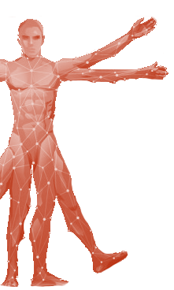
RPM System
Blood
Pressure
SpO²
Data Management
(Dashboard)
Data Presentation
(Graphs)
Data Analysis
(Alerts)
Augmented Intelligence (AI)
(Trends)
Blood
Sugar
Cam
Heart
Rhythm
Screen
4G
Secure
Cloud Storage
Hub
Heart
Rate
WiFi
Activity
Level
Scale
EMR/EHR
Collection
Transmission
Storage
Review

Slide 10
RPM Use Cases
One Solution, Many Uses
RPM in a Clinical Setting
  Intensive Care (eICU)
  Non-intensive Care (e.g., SNF)
RPM in a Home or Home-like Setting
  “Hospital at Home” models (early discharge)
  Short-term readmission prevention
  Long-term chronic disease management
  Long-term disease onset monitoring (at risk pop.)

Slide 11
Clinical Use Cases for RPM
Chronic
Disease
Readmission
Prevention
HTN
DM
CHF
COPD
ARF
CRF
AMI
CV Dx
Disease
Management
Post-Discharge
Management
Hospital
at Home
Onset of
Disease

Slide 12
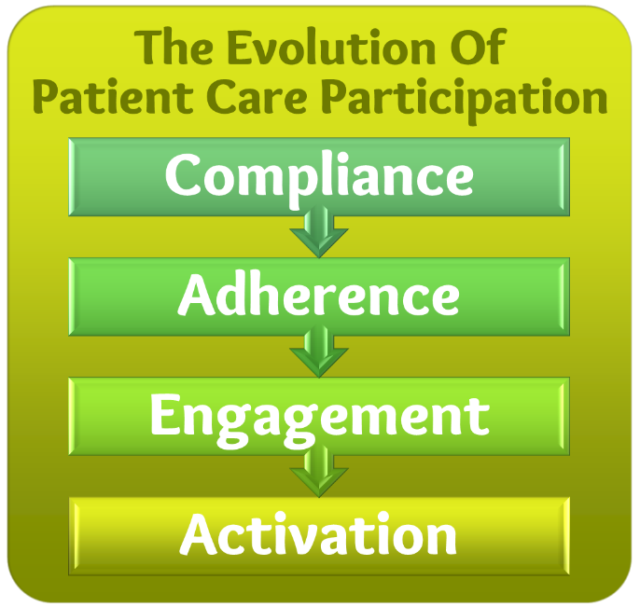
RPM: Clinical Benefits
Clinical Care Quality
Daily Insights allowing adjustment of the Care Plan
Better “exam” capabilities – not “flying in the dark”
With video capabilities, opportunities for interactive visits
Establishing a Baseline to detect onset of disease
Patient Engagement
“Seeing your body” increases patients’ engagement
Opportunities for Just-in-Time Education of patients

Slide 13

PREPARING
To Launch
A Telehealth Service

Slide 14
Service Verification
Service Definition
Ingenium
Telehealth Service
Launch Process
Service
Validation
Service Implementation
(c) 2016-2025 by Ingenium Consulting Group, Inc.

Slide 15
Service Verification
6 – 15
weeks
Strategic
Case
Business
Case
Clinical
Case
Service Definition
Ingenium
Telehealth Service
Launch Process
Workflow
Technology
Operatio-
nalization
Service
Validation
Service Implementation
Proof-of-
Concept
Organizational
Change
Methods
Deploy-
ment

Slide 16



RPM Launch Process: A Blueprint
Project Management & Team
RPM Strategy & Objectives
RPM Business & Clinical Case..
RPM Process/Workflow Design
RPM Performance Dashboard
Patient Selection Criteria & Process
Vendor/Technology Selection
Technology
Operatio-
nalization
Vendor-Optimized Workflow
Staffing
RPM Service Proof-of-Concept
RPM Service Deployment
(c) 2016-2025 by Ingenium Consulting Group, Inc.

Slide 17

Project Management & Team
Project Management & Team
Establish a Cross-Disciplinary Project Team:
  Senior Leadership:
  Clinical Operations, Pt. Services, IT, Finance
  Active Clinical Participation
  by Primary Care Providers, Nursing/Mas is KEY!
Select a Project Manager
Secure access to a Clinical Workflow Designer

Slide 18
Making The Case
RPM Strategy & Objectives
RPM Business & Clinical Case..
Strategic
Case
Business
Case
Clinical
Case

Slide 19

Strategic
Case
STRATEGIC CASE
Defines the alignment with
“external” strategic objectives
Organizational Strategy
Telehealth / Digital Health Strategy
Grant Goals (e.g., HTN Management)
Notes:
https://ingeniumdigitalhealth.com/clinician-engagement-for-digital-health-adoption

Slide 20
STRATEGIC CASE for RPM
Strategic
Case
How does your RPM Service
align with your organization’s
Strategic Objectives?
Services – e.g., expansion
Quality – e.g., pt. outcomes
People – e.g., pt. satisfaction
Finance – e.g., revenue
Growth – e.g., expansion
Community – e.g., stewards of health
Notes:
https://ingeniumdigitalhealth.com/clinician-engagement-for-digital-health-adoption

Slide 21
Business
Case
BUSINESS CASE
Describes the business model:
What is the value of delivering the service?
  Financial – but also Strategic & Clinical
  What is the revenue?
What is the cost of delivering the service?
  Hardware, Software Infrastructure
  Staff, Legal, Advisory/Consultative
  Launch vs. Operations
  Capital Expenses vs. Operating Expenses
What is the Return on Investment (ROI)?
Notes:
https://ingeniumdigitalhealth.com/clinician-engagement-for-digital-health-adoption

Slide 22

BUSINESS CASE for RPM
Business
Case
Financial Value
RPM Revenue
Incremental Visits Revenue
Any Penalties avoided or Shared Savings?
Any indirect savings (avoided readmissions)
Non-Financial Value
Patient Outcomes
Patient Loyalty
Other?
Cost
Monitoring Equipment (pp)
Monitoring Software Licensing Fee (pp/pm)
Operational and Clinical Support Staff Time (pp/pm)
Return on Investment (ROI): Calculate for 3 years.

Slide 23
Clinical
Case
CLINICAL CASE
Looks at the solution through a Clinical Lens
(because clinical acceptance is key to success!)
What is the clinical efficacy of the service?
  Is this validated by research?
  How will this improve health outcomes for patients?
  How can this help with clinical acceptance?
What is the clinical acceptance of the service?
  How will this help clinicians to do their job better?
Notes:
https://ingeniumdigitalhealth.com/clinician-engagement-for-digital-health-adoption

Slide 24

Benefits and Challenges of Remote Patient Monitoring as Perceived by Health Care Practitioners: A Systematic Review (Sep 2023)
Conclusion: Health care practitioners generally believe that RPM is feasible for application. Additionally, there is a consensus that telemonitoring strategies will become increasingly relevant. However, there are still drawbacks to the technology that need to be considered.

Slide 25

A systematic review of the impacts of remote patient monitoring (RPM) interventions on safety, adherence, quality-of-life and cost-related outcomes (July 2024)
Overall, RPM interventions have positively impacted patient safety, evidenced by reduced major complications and adverse events.
Outcomes on adherence are rather encouraging as well, with RPM interventions showing an overall upward trend in patient adherence to medication and lifestyle prescription as well as the odds of self-monitoring.
For cost-related outcomes, reduced risks of hospital admission/readmission, length of stay, number of subsequent follow-ups and non-hospitalisation costs are clearly observed.“

Slide 26
CLINICAL CASE for RPM
Clinical
Case
Patient Outcomes
Better managed Chronic Diseases Hypertension, Diabetes, etc.
Fewer ER visits, hospitalizations
Fewer Readmissions
Increased Patient Activation – more visits, prescriptions filled, health managed
Research Studies
RPM is proven to “work”
In my observation outcomes are greatly improved
  when clinicians actively “enroll” the patient and remain engaged
  when patients are actively engaged in the care

Slide 27
Create the Desired “End In Mind”
RPM Process/Workflow Design
RPM Performance Dashboard
Patient Selection Criteria & Process
Starting with The End in Mind
What would an “ideal experience look like”?
  For the patients? the clinicians? the monitoring/support staff?
How should data be presented? accessed? navigated? managed?
Which patients will you serve?
  Clinical Criteria (diagnoses, utilization history, medications, etc.)
  Non-Clinical Criteria (cognitive, dexterity, digital literacy, etc.)

Slide 28
RPM Workflow Roadmap
(1) Identification
(2) Enrollment
Qualify suitable patients. Assess clinical, psycho-social, technical factors.
Create Order. Obtain consent.
Initial training?
1
2
(4) Monitoring
(3) Equipment Setup
Continual monitoring. Resolution of issues.
Escalation when warranted
Setup and verify equipment at patient’s home.
4
3
5
6
7
(5) Recovery
(6) Refurbishing
(7) Post-Monitoring
De-Enrollment. Equipment Recovery.
Cleaning and Calibration.
Patient follow-up and/or tracking.
(c) 2020-2025 Ingenium Digital Health Advisors
Notes:
(4) Who monitors – in sourcing vs. outsourcing pros and cons (training, experience, scalability);
Determined and approved
Alert parameters - time frames to respond to alerts - patient education – not symptomatic, notes made;
(actionable data passed on)
Escalation processes –
After the first week adjust standard parameters; (or threshold regarding alerts)
[difficult to get custom alert parameters]

Slide 29
(1) Identification
1
Patient Selection Criteria & Process
Patient Selection Criteria
  Clinical
    Diagnoses, Admission/Utilization Medication History
  Non-Clinical
    Cognitive Abilities, Digital Literacy, Dexterity
Patient Identification Process
  EHR Reports? Population Health Reports?
  PCP Panel Review?
  Triggered by ED/Hospital Discharge?
HOW does
a patient
get identified?
(c) 2025 by Ingenium Consulting Group, Inc.

Slide 30



Inclusion/Exclusion Criteria
1
Patient Selection Criteria & Process
Clinical
Patient
Home
Diagnoses
Admissions/
Utilization
Medications
Other?
Evaluation
Dexterity
Cognitive Abilities
Digital Literacy
Assessments
Environmental
(e.g., tidiness)
Technical
(e.g., WiFi, cellular, outlets)
(c) 2020-2025 Ingenium Digital Health Advisors
Notes:
Home assessment: Even floor, electrical outlets.
Working phone (bills paid) – Obama phone (Federal phone, 20 minutes)

Slide 31
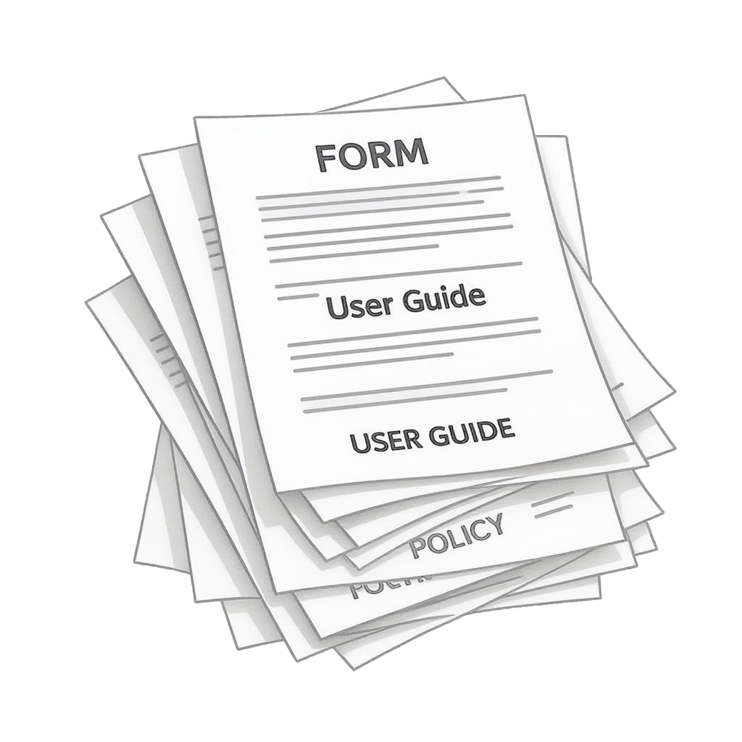
(2) Enrollment
2
RPM Process/Workflow Design
Personalized Enrollment by their PCP
Create an “RPM Order”
Validate Patient Competency
Obtain Consent, Authorization
Review Device Maintenance/User Guides
…and more
(c) 2025 by Ingenium Consulting Group, Inc.

Slide 32

(2) Enrollment
2
RPM Process/Workflow Design
1. Personalized Enrollment by their PCP
Lack of patient compliance to take regular
measurements is the biggest root cause of
failing RPM programs.
Patients need to know WHY from a person
they trust
PCP: “This is about you. This is about your family and friends.”
“You have only one chance to
make a first impression.”
ingeniumdigitalhealth.com/resources/rpm
(c) 2025 by Ingenium Consulting Group, Inc.

Slide 33
(2) Enrollment
2
RPM Process/Workflow Design
2. Create an “RPM Order”
  Reason for enrollment
  RPM “Prescription”: normal vital sign range, alert parameters/protocol
3. Validate Patient Competency
  Cognitive Abilities (e.g., comprehension, following instruction, remembering)
  Physical Abilities (e.g., dexterity, ADL)
  Digital Literacy (e.g., tech experience/savviness)
  Home Environment (e.g., alone, with family/caregiver)
  Connectivity (e.g., internet/WiFi, cellular reception)
  etc.
(c) 2025 by Ingenium Consulting Group, Inc.

Slide 34
(3) Equipment Setup
3
RPM Process/Workflow Design
Patient Training
  Connecting Vital Sign Monitors (if needed)
  Obtaining Vital Signs
  Transmitting Vital Signs / Confirming transmission
  Basic Troubleshooting
Equipment Registration
  Create patient ID in system
  Register vital sign monitor IDs in sy
Equipment Setup
  By the patient or caregiver, CHW, Paramedic, etc. in the patients home
Test Transmission
  Scheduled test of vital sign collection and transmission
(c) 2025 by Ingenium Consulting Group, Inc.

Slide 35
(4) Monitoring
4
RPM Process/Workflow Design
RPM Performance Dashboard
Daily Monitoring Protocol
  Review Patient Panel daily or multiple times a day
  Process Warnings and Alerts
  Troubleshoot Issue
Process Warnings and Alerts
  Call patients about missed measurements
  Call patients about out of range measurements
    Ask patient to retake; ask about medications, unusual events, etc.
    Escalate to nurse
    Escalate to PCP
Troubleshoot Issues
  most commonly connectivity problems
(c) 2025 by Ingenium Consulting Group, Inc.

Slide 36
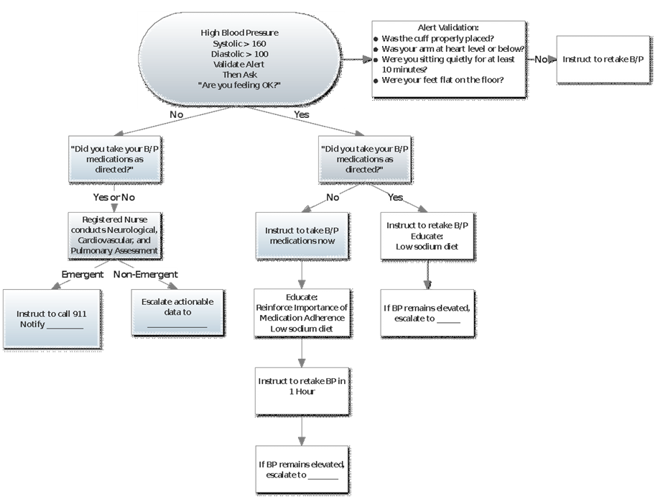

Slide 37
RPM Launch Process: A Blueprint
Project Management & Team
RPM Strategy & Objectives
RPM Business & Clinical Case..
RPM Process/Workflow Design
RPM Performance Dashboard
Patient Selection Criteria & Process
Vendor/Technology Selection
Technology
Operatio-
nalization
Vendor-Optimized Workflow
Staffing
RPM Service Proof-of-Concept
RPM Service Deployment
(c) 2018-2025 by Ingenium Consulting Group, Inc.

Slide 38


Vendor/Technology Selection
Vendor/Technology Selection
Vendor/Technology Selection comes AFTER workflow design
  Even if you have existing technology, first design your ideal workflow
    You may be able to achieve your ideal through tech configuration, workarounds
Don’t put the Horse behind the Cart
  Don’t “fall for the shiny object”
  Become an “educated buyer” first
  Figure out which “cart” to pull,
  before deciding on your technology
(c) 2016-2025 by Ingenium Consulting Group, Inc.

Slide 39


“If you don't know
where you’re going“
any vendor will gladly
take your money.”
#RequirementsEngineering
Christian Milaster
Digital Health Transformation Advisor
IngeniumHealthcareAdvisors.com
Notes:
002-Vendor-Money.png

Slide 40
RPM Service Design & Development
Vendor/Technology Selection
What is the desired, ‘happy day’ workflow?
What are the alternate & exception scenarios?
What are the features we expect from the Technology?
What Technology(s) can implement this service?
How do we operationalize the processes?
Workflow
Technology
Operatio-
nalization
(c) 2016-2025 by Ingenium Consulting Group, Inc.

Slide 41
Vendor Selection CRITERIA (SAMPLE)
Vendor/Technology Selection
User Experience
  For Patients
  For Monitoring Nurse
  For Providers
  For Support Staff
Workflow Compatibility
  Can it accommodate your
  desired workflows?
Feature Set
  Number of Vital Signs
  Bluetooth vs. Cellular vs. WiFi
  Dashboard, Analysis
  Pt. Reminders, Pt. Education
  Video Visit Capabilities
  etc.
EHR Integration
  Level of integration
  Ease of navigation to/from EHR
(c) 2023-2025 by Ingenium Consulting Group, Inc.

Slide 42
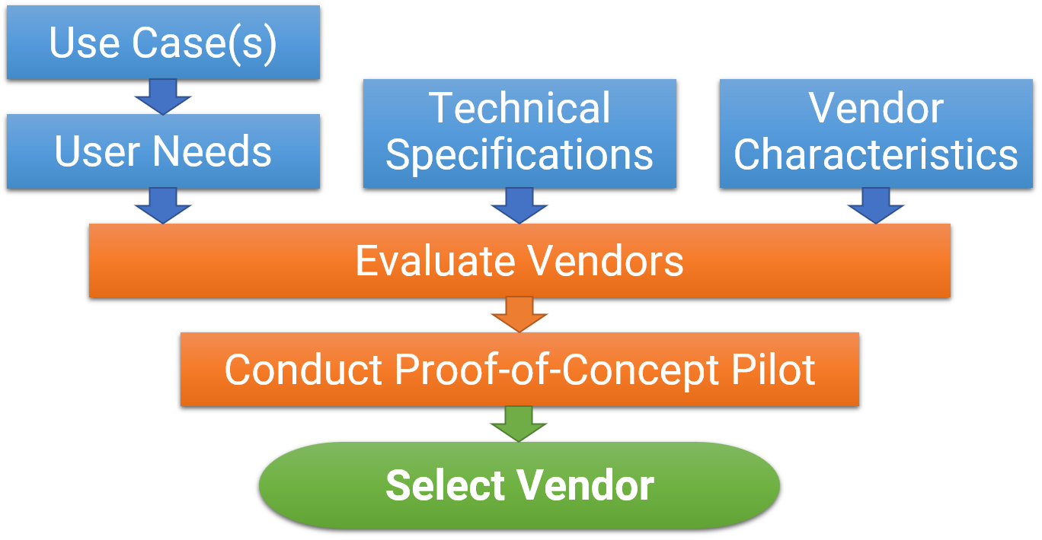
Vendor Selection Process
Vendor/Technology Selection
(c) 2023-2025 by Ingenium Consulting Group, Inc.

Slide 43

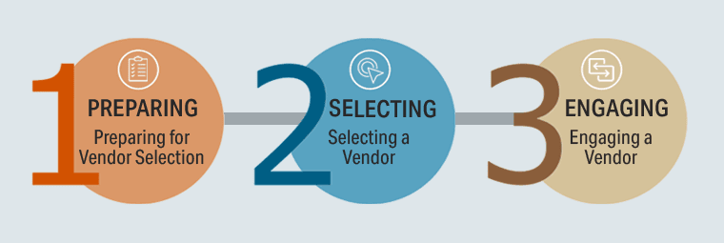
MATRC Vendor Selection toolkit
matrc.org/explore-telehealth/matrc-vendor-selection-toolkit/

Slide 44
RPM System Options
Vital Sign
Monitoring
BYOD
Purchased
Leased
Vital Sign Devices
Vital Sign
Data Collection,
Transmission
Review & Analysis
BYOD
RPM Vendor
Home Hub/Tablet
Call
In
Wireless (Bluetooth) Automated
Clinical Dashboard
Apps on
Phone/Tablet
Hub
Tablet
Logistics
Deployment & Setup
Retrieval & Refurbishing
DIY
RPM
Technology
Vendor
RPM
Service Provider
Technical/Operational Support
Clinical Management
Internal (RNs)
External (RNs)
Internal (Physicians)

Slide 45
Operationalization
Vendor-Optimized Workflow
Staffing
After Vendor Selection: update your workflows & guides
  Modify your Workflows to Fit the Vendor Solution
  Update/Create the Patient-facing User Guides
  Update the Monitoring Guide
Staffing Considerations
  Who identifies the patient? (step #1)
  Who enrolls the patient? (step #2)
  Who assists the patient in the technology set up? (step #3)
  Who monitors the patient data, follows up, troubleshoots,
  triages, escalates, adjust the care plan (step #4)

Slide 46
Operationalization
Vendor-Optimized Workflow
Staffing
Monitoring Nurse/Staff Considerations:
1 FTE for approx. 75-150-200 patients (but 0.2 FTE for ~25 pts.)
Could also be a technician + RN (for clinical calls)
Vendors to outsource monitoring staff exist:
  Many vendors are tied to their own RPM solution
  Some vendors are technology-agnostic
PRO TIP
Prior to outsourcing,
launch your program in house,
but with outside expertise.

Slide 47
RPM Monitoring Staff Options
Vendor-Optimized Workflow
Staffing
 | Clinical Activities | Logistics
Option A | Your RNs | Your Staff
Option B | Your RNs | Outsourced
Option C | Outsourced
Option D | Your RN/Staff + Outsourced Backup

Slide 48


We’d Like Your Input!
…for an “RPM Optimization Toolkit”

Slide 49

Please Complete the Survey
What RPM Guidance would be most helpful to you?
forms.gle/ikVhKBRKS8UeovMp9
1) What is the status of your RPM Program?
2) What kind of RPM Technology do you have?
3) Which areas do you find most challenging?
Identification of Patients
Enrollment/Setup of Patients
Patient Engagement/Compliance
Technology–Selecting & Troubleshooting
Technology–Support/Using Monitoring Devices
Technology–Selecting/Using RPM Dashboard
Graduating Patients
Financial Sustainability
Clinical Efficacy
Strategic Relevance

Slide 50



Subscribe to Telehealth Tuesday
(a weekly column)
````
Christian Milaster
Christian @ Ingenium Advisors.net
IngeniumDigitalHealth.com
657-Ingenium (657-464-3648)

Slide 51
After the Q&A
Proof-of-Concept
Key Takeaways
Action Items
Webinars Outlook
Contact Info:
Christian.Milaster@IngeniumAdvisors.net
IngeniumDigitalHealth.com
657-Ingenium (464-3648)

Slide 52

LAUNCHING
Remote Physiological Monitoring

Slide 53
RPM Launch Process: A Blueprint
Project Management & Team
RPM Strategy & Objectives
RPM Business & Clinical Case..
RPM Process/Workflow Design
RPM Performance Dashboard
Patient Selection Criteria & Process
Vendor/Technology Selection
Technology
Operatio-
nalization
Vendor-Optimized Workflow
Staffing
RPM Service Proof-of-Concept
RPM Service Deployment
(c) 2018-2025 by Ingenium Consulting Group, Inc.

Slide 54

Purpose of a Proof-of-Concept
RPM Service Proof-of-Concept
The Proof-of-Concept is about Validation
  Most “pilots” are about “trying it out”, “see how it goes”
A Proof-of-Concept is a structured way to
systematically validate a new service and improve it
before the broader deployment.
Are you Still using Telehealth Pilots?

Slide 55
Pilot vs. Proof of Concept
RPM Service Proof-of-Concept
 | Pilot | Proof of Concept
Duration | A few weeks/months After a set number of patients completed. | Until Assumptions Validated
Success Criteria | Informal, “it works” | Formal success criteria – verifiable validation of critical assumptions
Mindset | Let’s see if this works. | Let’s validate our assumptions. Let’s improve the solution until it’s ready for deployment.

Slide 56
Proof-of-Concept (PoC) Process
RPM Service Proof-of-Concept
Identify & Prioritize Assumptions to Validate
  e.g., clinician satisfaction; patient compliance
Define Measuring Mechanisms for Priority Assumptions
  e.g., paper survey, collected daily during PoC; RPM reports
Set Targets for Priority Assumptions
  e.g., >= 4.5 on a 5-point Likert Scale; 85% compliant
Pre-define Corrective Action
  e.g., talk to clinician about causes of dissatisfaction; Pareto-Analysis
Start with Champions with an Early-Adopter Mindset & Attitude
  We’ll win over the “late majority”….later

Slide 57
RPM Deployment
RPM Service Deployment
After…
  Successful conclusion of Proof-of-Concept (assumptions validated)
  Improvement/update of all workflows, policies, guides, training
Prepare for broader deployment
  E.g., involve more PCPs; increase eligibility criteria; expand vital signs

Slide 58
Change Management
RPM Service Deployment
Most important root cause of failures in launching new services is not managing the Change.
Humans are very clever and creative to resist change.
It is part of Human Survival.
To get people to do things differently, you need to “enroll them”, appeal to their heart and to their minds, and make the change look “easy”.

Slide 59
ADKAR Framework
Raise AWARENESS
  Define the Vision, promote the Solution
Create DESIRE
  Demonstrate the Benefits
Supply KNOWLEDGE
  Use experienced advisors & train adequately
Build ABILITY
  Provide opportunities for Learning
Supply REINFORCEMENT
  Ensure Accountability, Continuity, Support

Slide 60
Without Change Management…
Clinicians
Staff
Patients
Leadership
confused
embarrassed
frustrated
reluctant
resistant
will
become

Slide 61
ADKAR Model for Successful, Sustainable Change
Awareness
Desire
Knowledge
Ability
CHANGE!
Reinforcement
Awareness
Desire
Knowledge
Ability
Confusion
Awareness
Reinforcement
Awareness
Desire
Knowledge
Ability
Resistance
Desire
Reinforcement
Awareness
Desire
Knowledge
Ability
Reluctance
Knowledge
Reinforcement
Ability
Frustration
Awareness
Desire
Knowledge
Ability
Reinforcement
Awareness
Desire
Knowledge
Ability
Backsliding
Reinforcement
Reinforcement

Slide 62
RPM Launch Process: A Blueprint
Project Management & Team
RPM Strategy & Objectives
RPM Business & Clinical Case..
RPM Process/Workflow Design
RPM Performance Dashboard
Patient Selection Criteria & Process
Vendor/Technology Selection
Technology
Operatio-
nalization
Vendor-Optimized Workflow
Staffing
RPM Service Proof-of-Concept
RPM Service Deployment
(c) 2018-2025 by Ingenium Consulting Group, Inc.

Slide 63
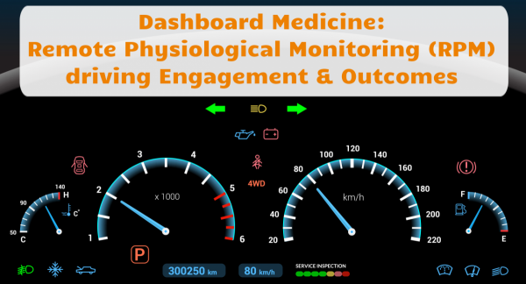

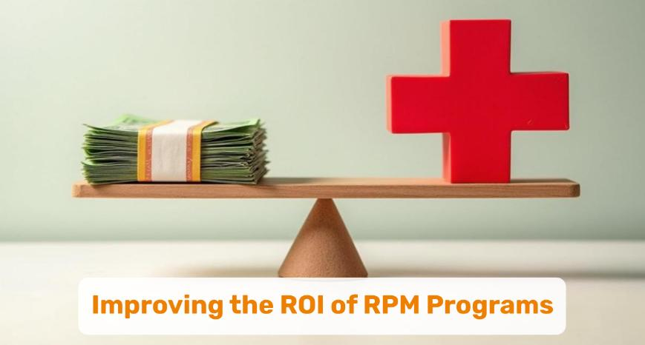
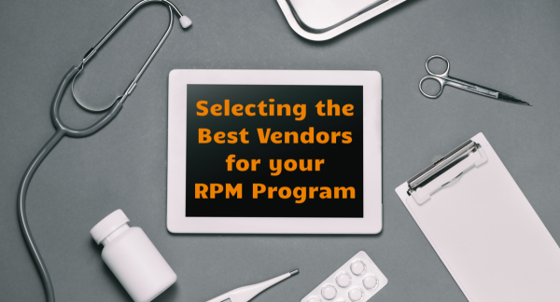

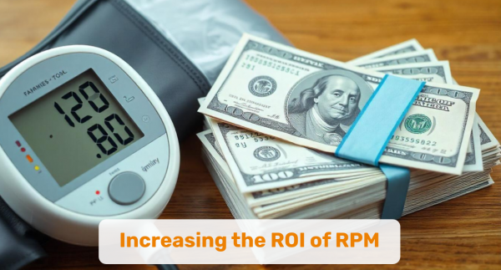
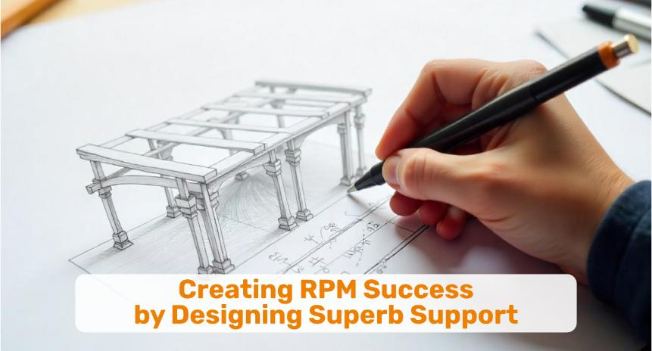

Telehealth Tuesday Collections
Remote Physiological Monitoring (RPM)
Dashboard Medicine: RPM
driving Engagement & Outcomes
5 Reasons
Why RPM Programs Fail
Improving the ROI
of RPM Programs
Selecting The Best Vendors
for Your RPM Program
For RPM Success,
Workflows are Key
Increasing
the ROI of RPM
Creating RPM Success by Designing Superb Support
Patient Activation:
The Secret to RPM Success
IngeniumDigitalHealth.com > Resources > Optimizing Telehealth > RPM
Notes:
FINAL

Slide 64
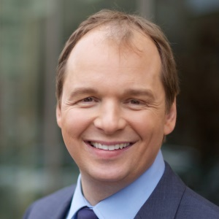


CONTACT
CONNECT
Christian Milaster
Founder & CEO Ingenium Digital Health Advisors
Christian.Milaster@IngeniumAdvisors.net
(657) 464-3648
Thank
You!
/in/ChristianMilaster

