Slide 1
Billing Compliance & Measurement for VBC
One is here now & one is in the future
Irene V. Hilton, DDS, MPH, FACD
NNOHA Dental Consultant
March 26, 2021

Slide 2
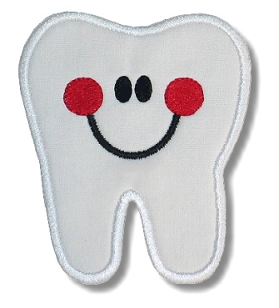

Objectives
Identify common areas of billing non-compliance
List the elements of proper documentation of medical necessity
Understand the importance of learning to measure for quality

Slide 3
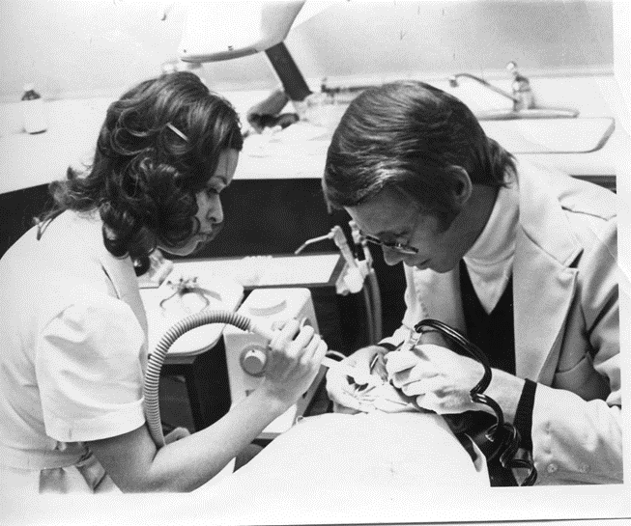
About NNOHA
Founded in 1991 by FQHC Dental Directors who identified a need for peer-to-peer networking, collaboration, research, and support
Membership now includes more than 3,500 dentists, dental hygienists, supporters, and partners

Slide 4
HRSA National Oral Health Training/Technical Assistance Grantee
Learning Collaboratives
Annual Conference
Webinars
NNOHA Listserv
NOHLI
Resources – Operations manuals, dental forms library,
www.nnoha.org or email info@nnoha.org

Slide 5
Billing Compliance

Slide 6
Why Medicaid MIP Audits?
Section 6411(a) of the ACA requires State Medicaid program to establish a recovery audit program to audit claims for services
CMS manages billions in State and Federal Medicaid expenditures each year
Good government principle has to have accountability

Slide 7
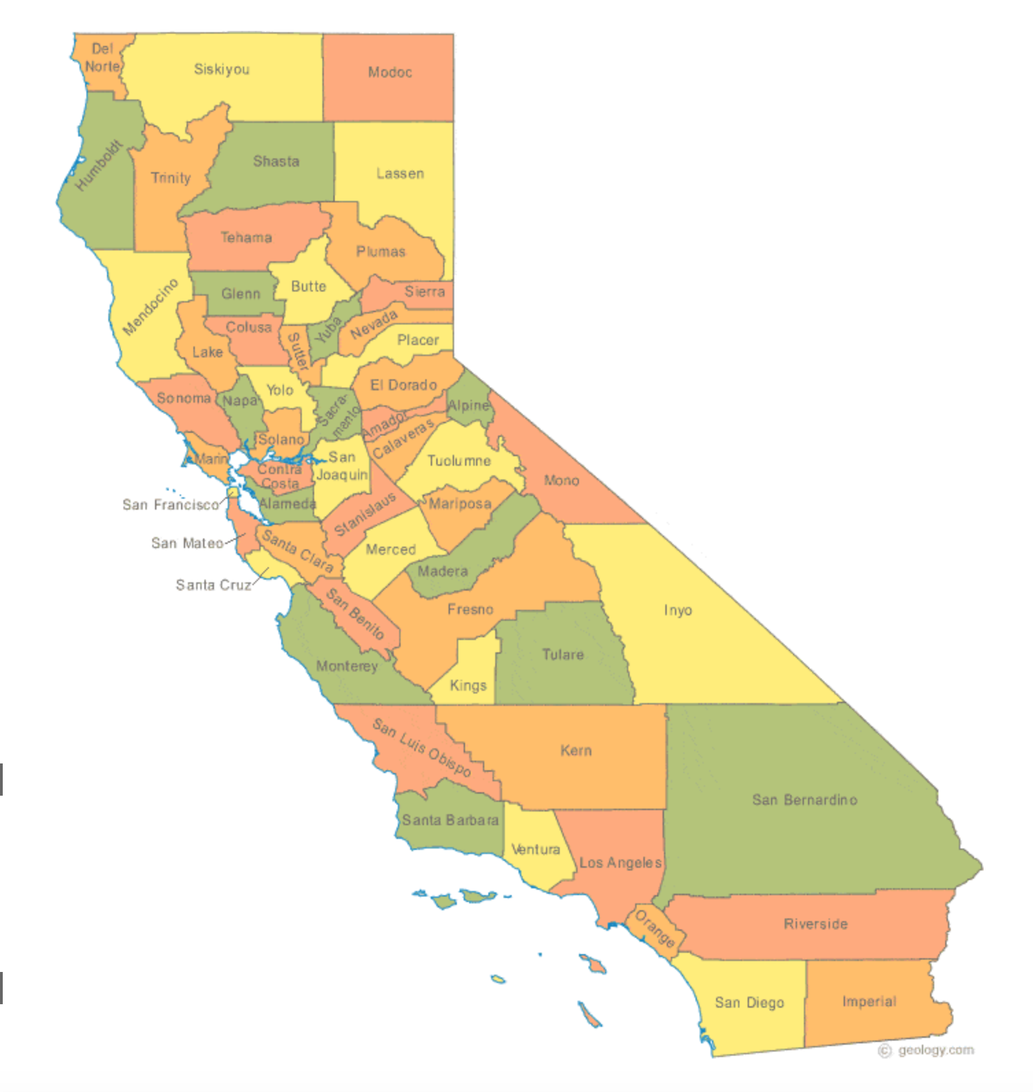
The California Experience 2015
Largest FQHCs targeted
Extrapolation
Initially 20 million in repayment from 5 FQHCs
Advocacy- state and federal lobbyists, NACHC, members of congress

Slide 8
Insufficient Documentation
No clinical documentation for the date of service billed.
Unknown provider and/or missing provider signature.
No patient record
Undated records

Slide 9
Excessive Visit
Exam and prophy completed less than 6 mo prior. Guidelines state "prophylaxis and fluoride are a benefit once in a six-month period without prior auth”.
How do we prevent this?

Slide 10
Excessive Visit
Prophy should have been completed with exam on 11/6/13.
Coding auditor comment: This service is excessive.
How do we prevent this?

Slide 11
Excessive Visit
This tooth should have been treated at restorative visit on 12/17/14 as 1 sealant is a simple procedure.
Coding auditor comment: This service is excessive.
How do we prevent this?

Slide 12
Excessive Visit
This sealant should have been completed on 8/23/14. Documentation states this is a re-do but this was a scheduled visit. This is excessive.
How do we prevent this?

Slide 13
Excessive Visit
This post op check is not necessary.
How do we prevent this?

Slide 14
Excessive Visit
This eval appt is not necessary. Pt has been seen several times for perio appts and documentation states the distal wedge procedure is healed/successful. It is excessive to re-eval this area again.
How do we prevent this?

Slide 15
Excessive Visit
This visit is excessive as no treatment or exam was completed at this visit. This pt had been referred to oral surgeon at previous visit. She should not have been scheduled for this visit.
How do we prevent this?

Slide 16
Not Medically Necessary
EXT #I Radiographic evidence does not show that this treatment was medically necessary.
Coding auditor comment: This service has insufficient documentation to determine medical necessity.
How do we prevent this? Or document the medical necessity?

Slide 17
Poll
After hearing about all these different scenarios, my opinion is:
  None of these visit should’ve been flagged
  I agree with a few of the findings but most should not have been flagged
  I agree with most of the findings but a few should not have been flagged
  I agree with all of these findings

Slide 18


Slide 19
DOCUMENT
DOCUMENT
DOCUMENT

Slide 20

#1 Rule of Documentation
If it is not documented = It did not happen

Slide 21
Documentation Hints
Write treatment note as soon as possible
Adapt a standard format for routine and emergency case write-ups (i.e. SOAP) and use it consistently
With EDR can template treatment notes

Slide 22
Treatment Record Must
SUPPORT the diagnosis
JUSTIFY the treatment
RATIONALIZE what was done or not done
DOCUMENT the results of treatment
IT IS NOT ENOUGH TO SAY
WHAT YOU DID, YOU MUST
DOCUMENT WHY!

Slide 23
Documenting Medical Necessity
Service | Medical Necessity Documentation Needed
Caries | Needs immediate attention, x-ray taken, penetration of dento-enamel junction
Stainless Steel Crown | Primary or permanent posterior tooth, loss of tooth structure not repairable with amalgam or composite, for posterior permanent teeth-patient must have mental or physical condition that limits ability to tolerate the procedure for placement of different crown
Full Mouth Debride | Provided prior to comprehensive exam, patient has not had dental care for at least 3 years, plaque and calculus inhibit comprehensive exam, unable to complete periodontal probing, cannot visualize tooth structures
Root Canal Treatment | Presence of extensive decay, infection, draining fistulas, severe pain upon chewing or applied pressure, prolonged sensitivity to temperature, or discolored tooth indicative of a non-vital tooth
Developed by Iowa Primary Care Association

Slide 24
Compliance Program
Establish internal compliance program
Designate compliance officer or contact
Training and education
Respond to issues and improve systems

Slide 25
Good Records…
Let you sleep at night
Are your best defense
Never hurt you

Slide 26
Teledentistry Compliance
Know NY state Medicaid teledentistry regulations (Jan 2020)
  https://www.health.ny.gov/health_care/medicaid/program/update/2020/2020-01.htm#telehealth
  D9995 tele-dentistry synchronous
  D9996 tele-dentistry asynchronous
Additional consent to document
All else is as if in-person
  Quality
  Documentation

Slide 27
NY DOH June 2020 Medicaid Update
https://www.health.ny.gov/health_care/medicaid/program/update/2020/no11_2020-06.htm#dental
“during the State of Emergency, telehealth includes telephonic, telemedicine, store and forward, and remote patient monitoring. Telemedicine includes teledentistry.”
“Services rendered should be appropriate for telehealth (teledentistry) and within the provider's scope of practice.”
Payment for procedures done, NOT teledent

Slide 28
Measurement for Value Based Care

Slide 29
Poll
Dental quality measurement my health center:
  We measure one thing, the UDS sealant measure because we have to
  I would like to measure more things but I don’t know where to start
  My administration would like to measure more things but we don’t know where to start
  We are collecting and reporting regularly on at least three dental quality measures

Slide 30
UDS Sealants Measure
42% 2011-16 NHANES 6-11 y/o

Slide 31
Value Based Care
CMS currently defines value-based care as paying for health care services in a manner that directly links performance on cost, quality and the patient's experience of care
a clear, shared vision with the patient at the center
leadership and professionalism of health care workers
a robust IT infrastructure
broad access to care
payment models that reward quality improvement over volume

Slide 32
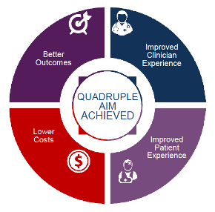
Reality of now vs. Future
Definition of value
How will it be measured?
Definition of oral health outcomes/ quality?
For now- widgets

Slide 33
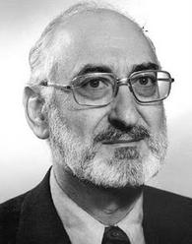
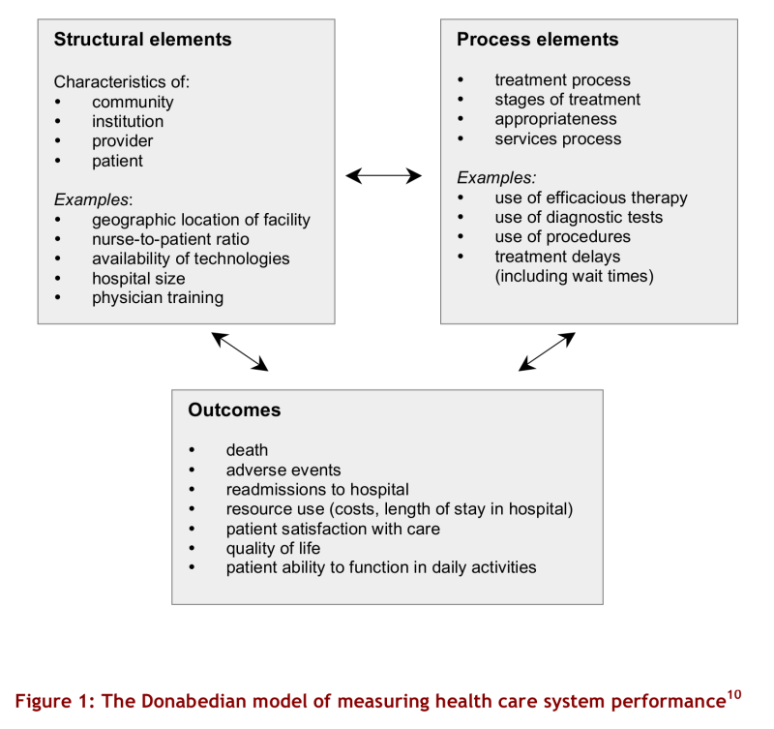
Measuring Quality (1966)

Slide 34
Applied to Oral Health
System
Use of guidelines
Number of team members
Case management
Referral management
Data systems
Health Outcomes
Process of Care/widgets
Oral cancer screening
Risk Assessment
Fluoride
Sealant
Periodontal treatment
Smoking cessation
Cancer incidence
Caries status
Periodontal status
Glycemic control
Quality of life
Cost

Slide 35

Counting Widgets = Measurement
How will we know whether a change is an improvement = measurement
All roads lead to measurement
VBC based in measurement
Don’t wait…learn to measure

Slide 36
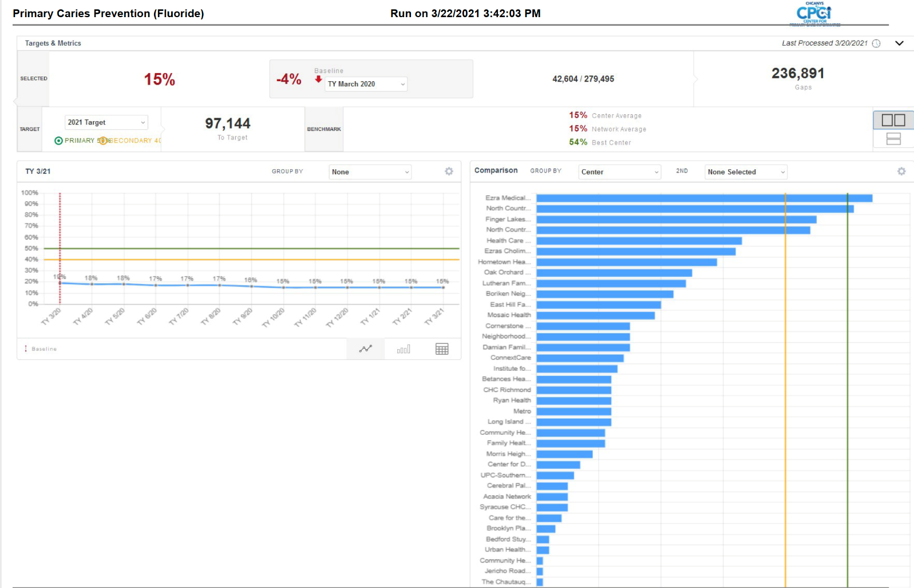
State-Level Aggregation- CHCANYS Azara

Slide 37
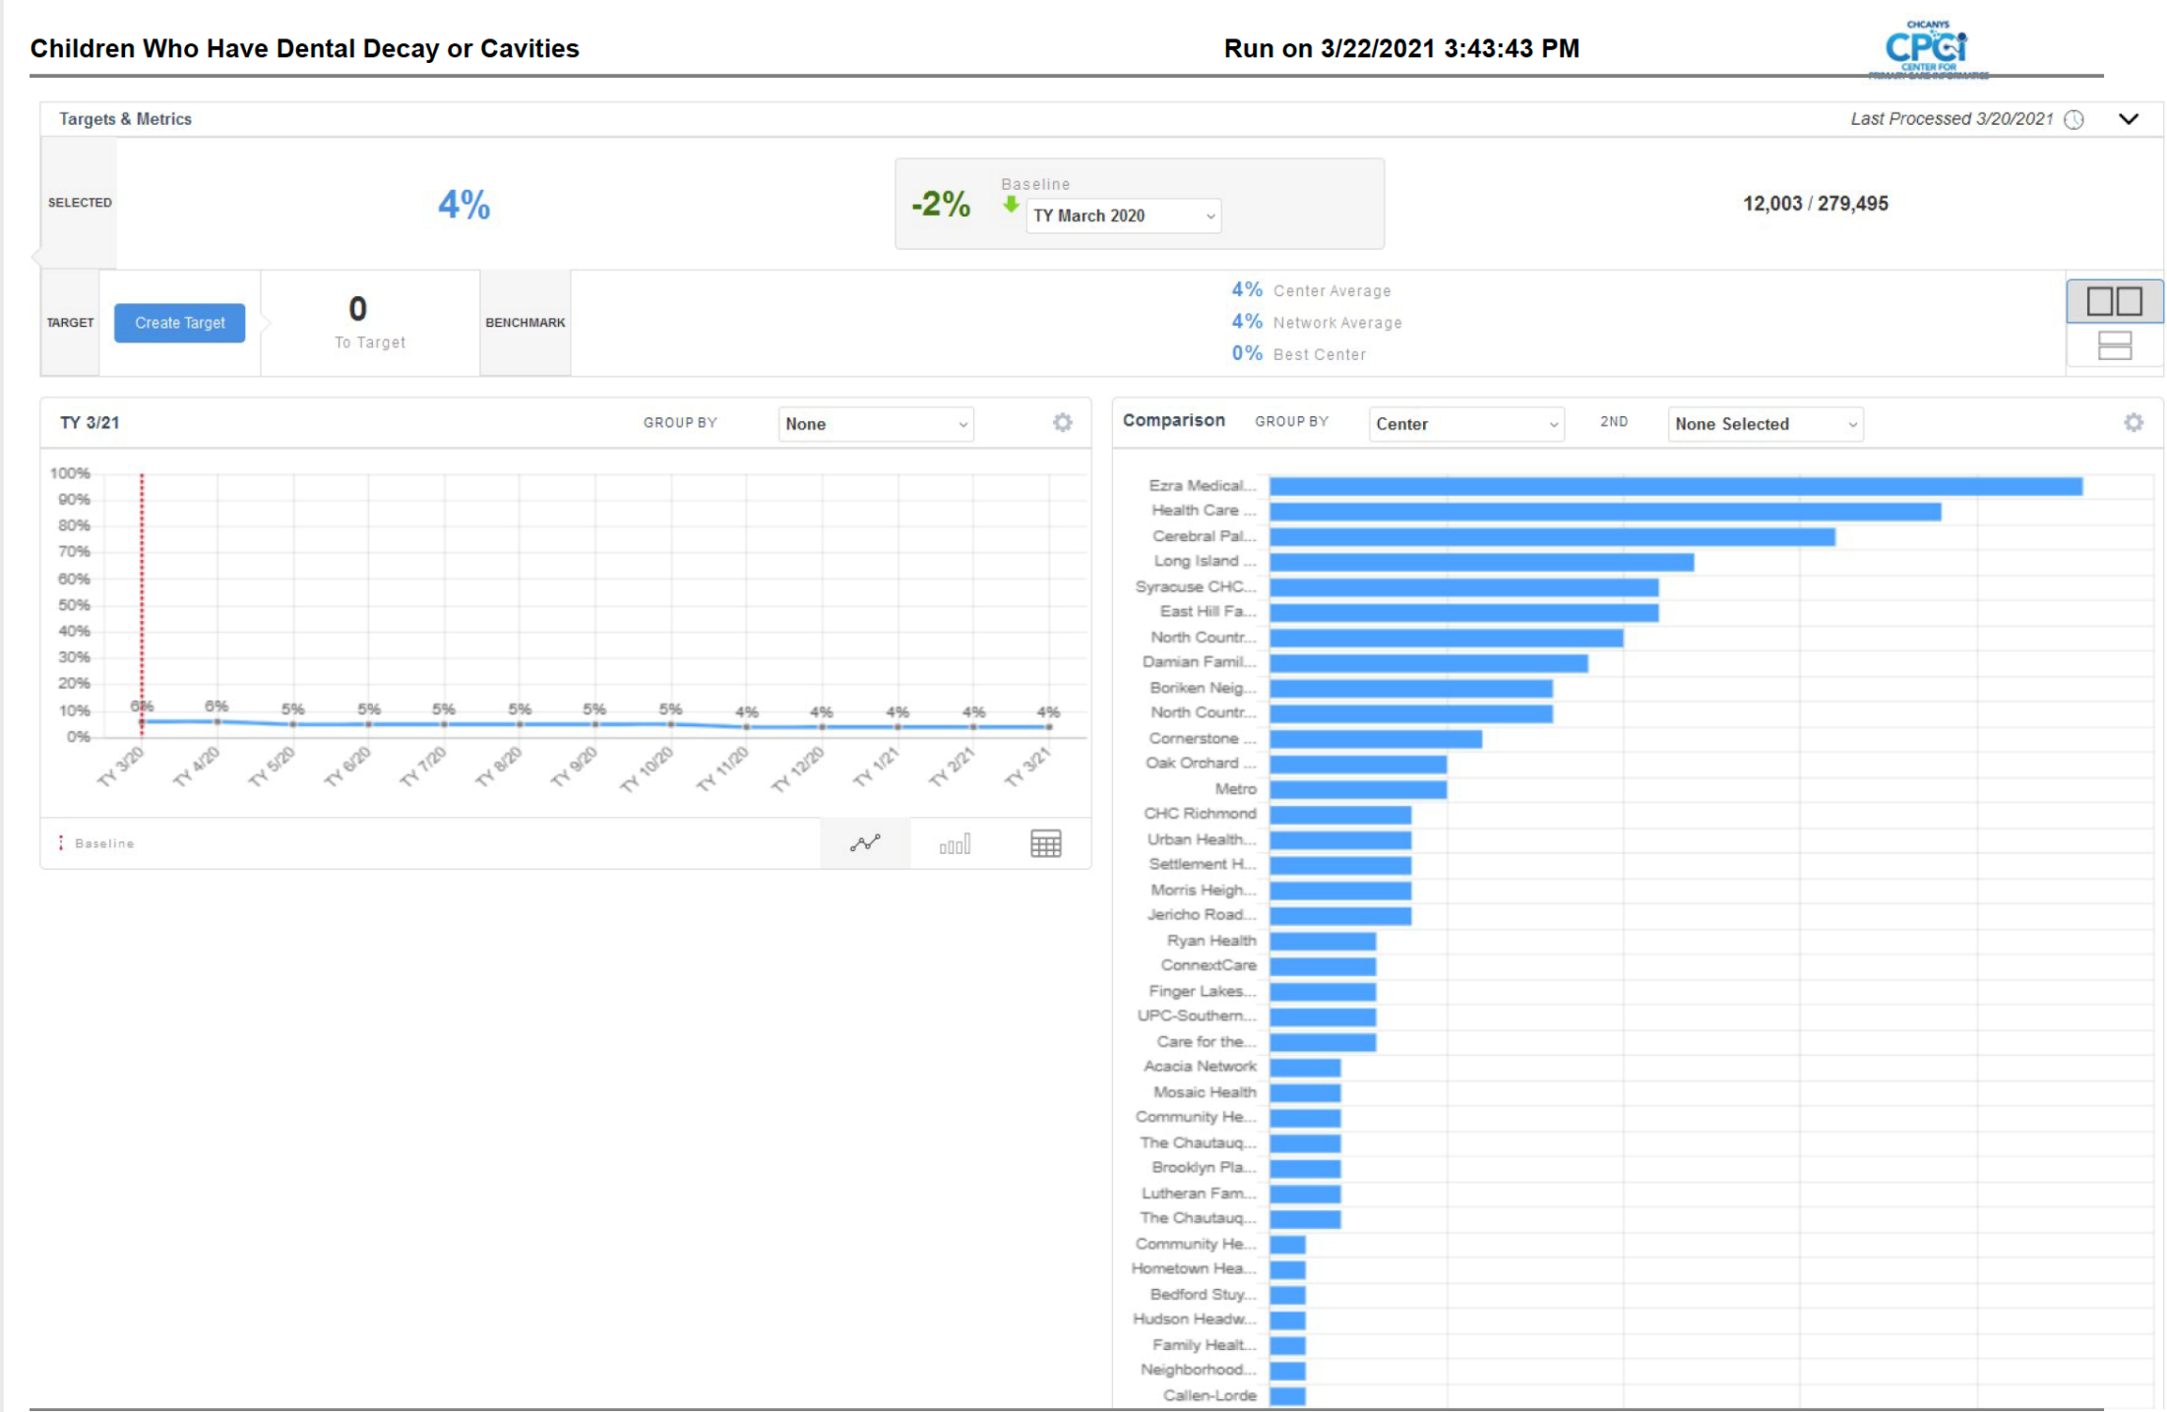

Slide 38
Current VBC
HRSA Quality Improvement Awards: 117M for 2020
California 1115 Waiver Dental Transformation Initiative: 139M yearly x 5 years
Oregon ACO: Incentives for percentage panel dental utilization, retention of global payments with less emergency room utilization
Liberty Dental Pilot- $100 for CRA level reduction

Slide 39
Know How to Measure
Besides UDS Sealants, more clinical measures
  FL, CRA, SMG
Systems
  Dual users, emergency to exam
Patient satisfaction, OHQOL

Slide 40
Upcoming Webinar
Patient-Centered Strategies for Teledentistry: The Potential Business Case – April 14 at 4pm EDT
  https://nnoha.org/event/webinar-patient-centered-strategies-for-teledentistry-the-potential-business-case/

Slide 41
NNOHA at Night
Wine Tasting for the Oral Health Professional – April 8 at 7pm EDT
  https://nnoha.org/nnoha-at-night-wine-tasting-for-the-oral-health-professional/
Parenting During the Pandemic – April 20 at 7pm EDT
  https://nnoha.org/event/nnoha-night-parenting-during-the-pandemic/

Slide 42
NNOHA’s Annual Conference
In-person at San Antonio, TX
  November 14-16, 2021
Online select – on-demand option starts November 14.
Now accepting abstracts! Registration coming soon!

Slide 43
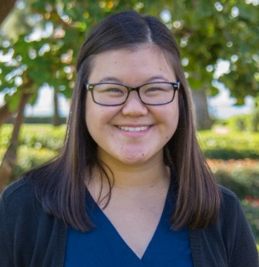
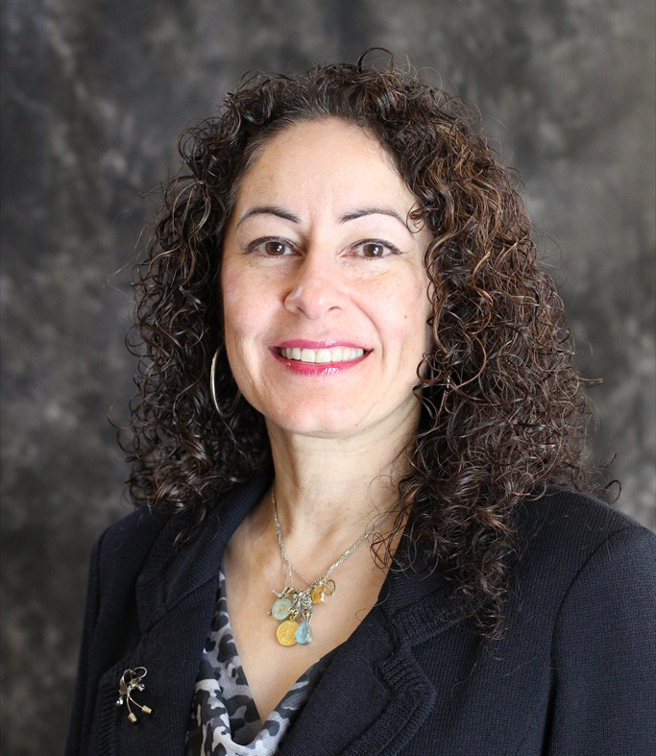
Contact Us!
Candace Owen, RDH, MS, MPH
NNOHA Education Director
candace@nnoha.org
Irene V. Hilton, DDS, MPH, FACD
NNOHA Dental Consultant
irene@nnoha.org
National Network for Oral Health Access
181 E 56th Avenue, Suite 401
Denver, CO 80216
Phone: (303) 957-0635
Fax: (866) 316-4995
info@nnoha.org

Slide 44
This project is/was supported by the Health Resources and Services Administration (HRSA) of the U.S. Department of Health and Human Services (HHS) as a part of an award totaling $625,000 under grant number U30CS29051 with 0% financed with non-governmental sources.
The contents are those of the author(s) and do not necessarily represent the official view of, nor an endorsement, by HRSA, HHS, or the U.S. Government.
For more information, please visit HRSA.gov

Slide 45
Questions?

