Slide 1

Healthcare
CENTER
HIPAA Risk Assessment

Slide 2

Problem Statement, Changing Environment
Increased use of electronic health record systems changes security risk
Increased use of IoT enabled mobile health and medical devices increases security risk
Increased use of cloud-based systems changes security risk
That can be a lot of security risks for small to medium-sized health centers to effectively manage!
Increased sharing between organizations and reliance on vendors
Notes:
Lets Talk about Risk,
1. Risk In the Medical Field Means something different to everyone!
a. A Brain Surgeon, Has a much higher risk threshold, Every day is life and death, every decision matters.
When you in IT --- How do you communicate risk to your organization, What does that look like?
How do you explain to a physician and medical staff the technology risk to the organization?
It has been my experience, being involved with 100s of large and small clinics that Patient care and Business objectives need to be at the center when doing a risk assessment.
1. If your to focused on technical compliance, (Like the auditors that search everyone's desk, your focus need more focus! ))
So what does our environment look like right now ! I have pulled information and screen shots directly from the dark web last week.

Slide 3
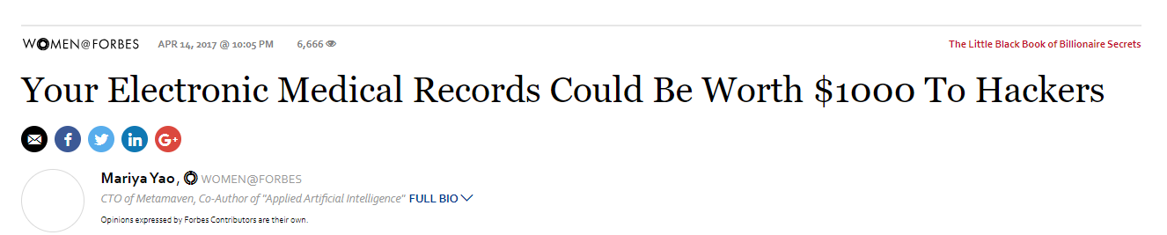
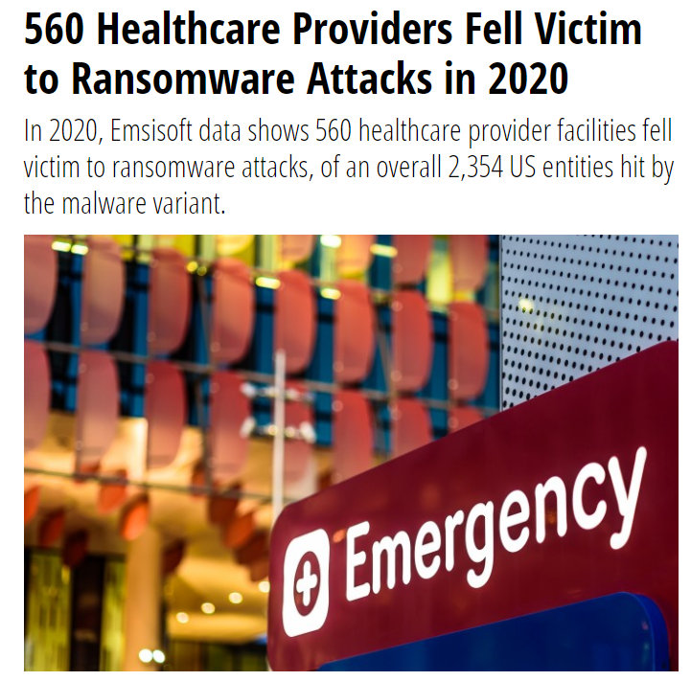
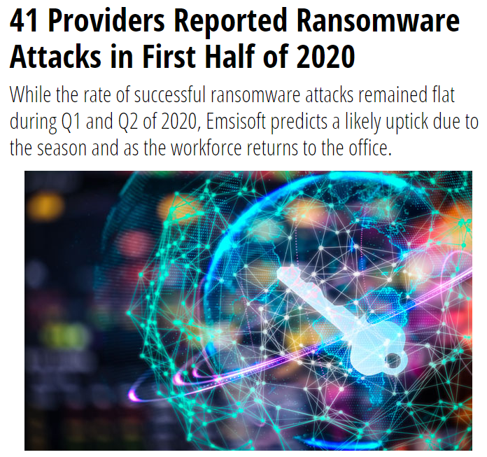
Are Clinics a Target?
https://www.forbes.com/sites/mariyayao/2017/04/14/your-electronic-medical-records-can-be-worth-1000-to-hackers/#571d3ece50cf
Notes:
2020 was an active year. I think with everyone remote. It embolden the hacker community to take advantage of the new environment. Same with state actors.

Slide 4
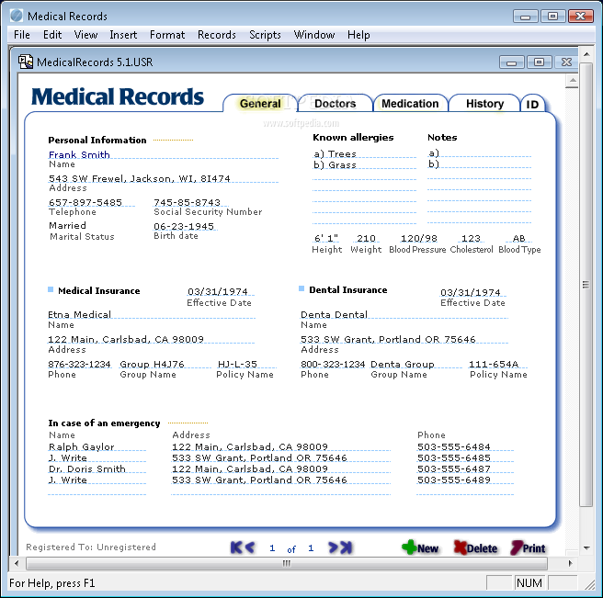
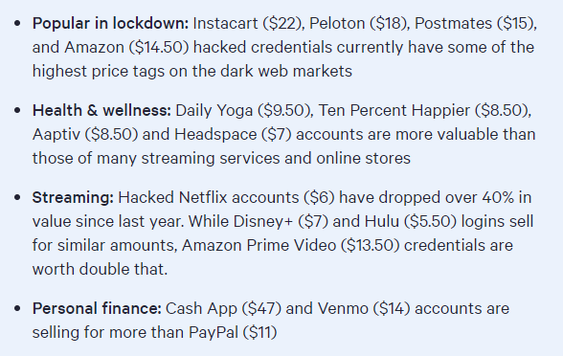
We’re not a Target…
Other Identification
 | Medical Record | Credit Card
Black Market Value per record | ~$5 | ~$.50
Demographics | Yes | Maybe
Payment Information | Yes | Yes
Lifetime of Information | Forever | Short
Risk to Consumer | High | Low
Privacy Concerns | High | Moderate
Name and Contact Info
SSN/SIN
Birth Date
Insurance Information
Payment Information
https://www.top10vpn.com/dark-web-market-price-index-2020/?gclid=CjwKCAiAmrOBBhA0EiwArn3mfLWpbLgF4qKfnE-fKfjSuaZ9BfOtgP5CjiBFMv6cpZt4N4M2iDIZoRoCiZkQAvD_BwE
Notes:
This is the normal information you see but let's look a little deeper into what actually is going on with the data that we are handling and how it can affect the patient

Slide 5
How Information is Used on the Dark Web
Health records will surface as a 'fullz' the slang term on the Dark Web for a complete long-form document containing of all the intricacies of a person's health history, preferred pharmacy, financial data and PII data.
What happens is the people who purchase those fullz then go to another vendor on the dark web for what's called dox, the slang term for documentation, where they then proceed to have documents made.
  Passports,
  Drivers' licenses,
  Social Security cards
All these things that will help the counterfeit imitation of the victim. So, you have electronic health record that will typically go for $20 apiece, and you'll spend a couple hundred dollars on 'doxs' to support that identity, and once it's an identity kit, you can sell it for $1,000 to $3,000."
Dark Web Add

Slide 6
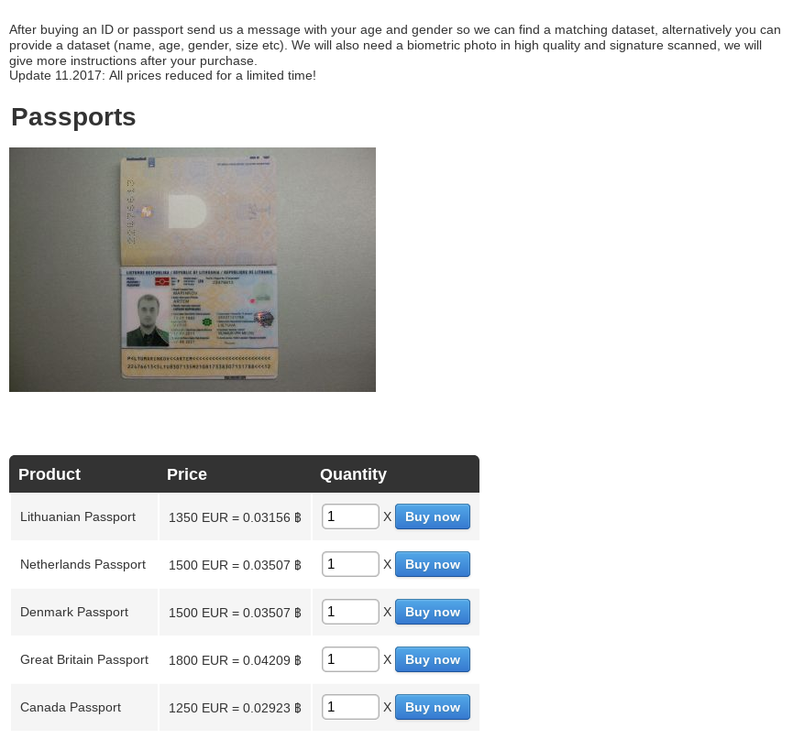
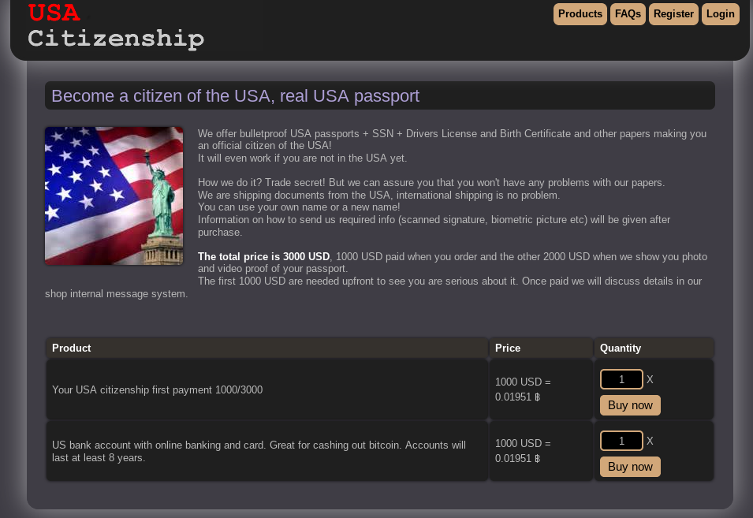
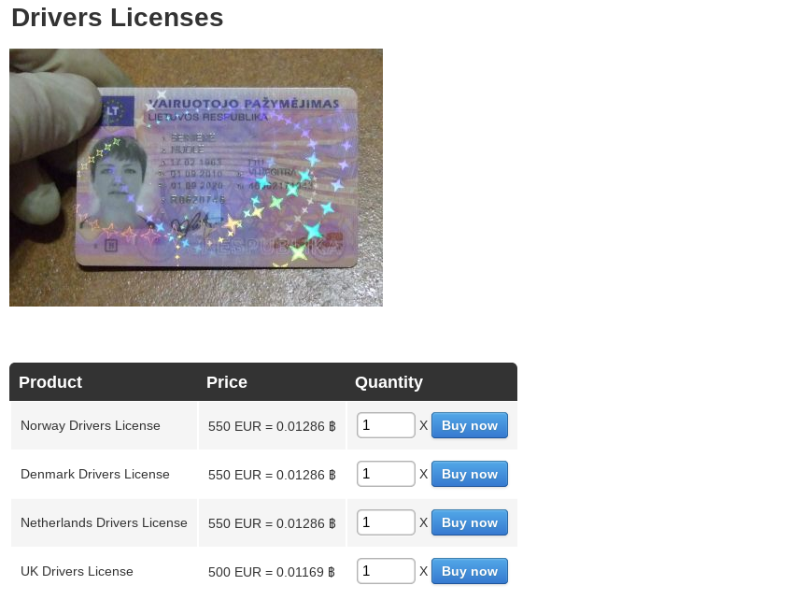
Dark Web Examples
“Identity Kit”

Slide 7
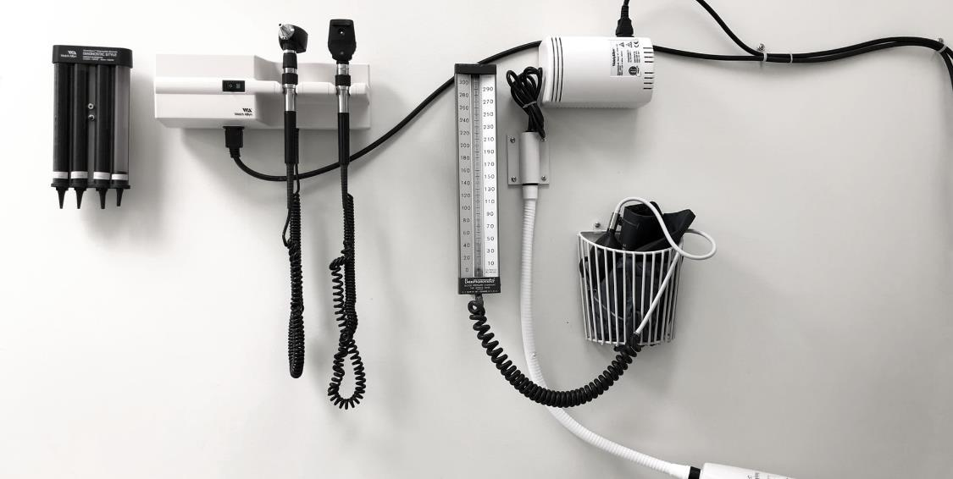
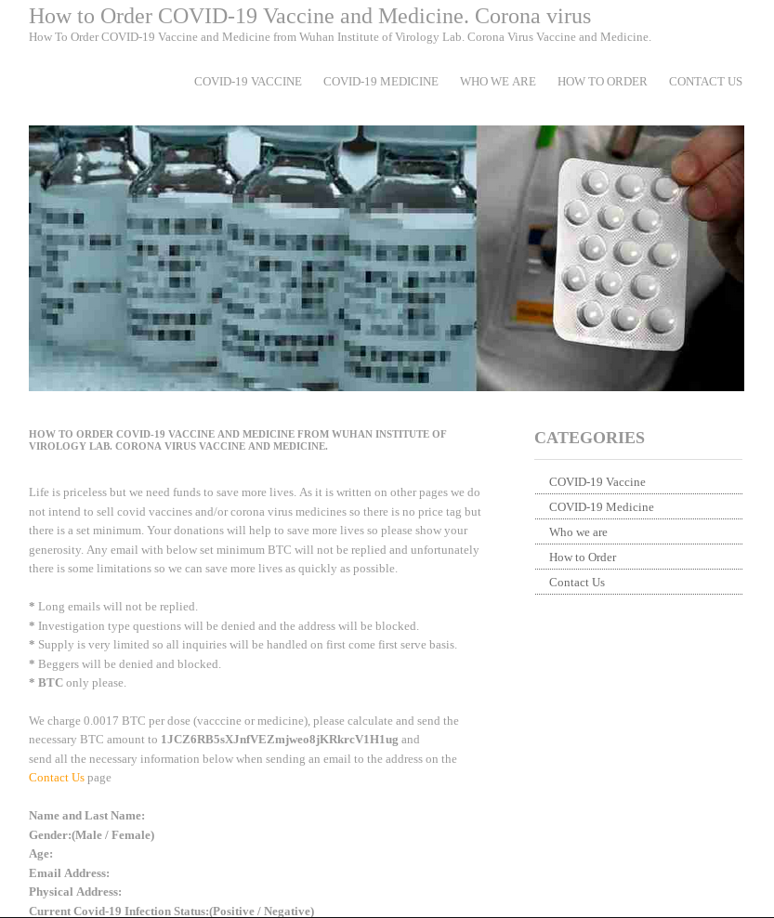
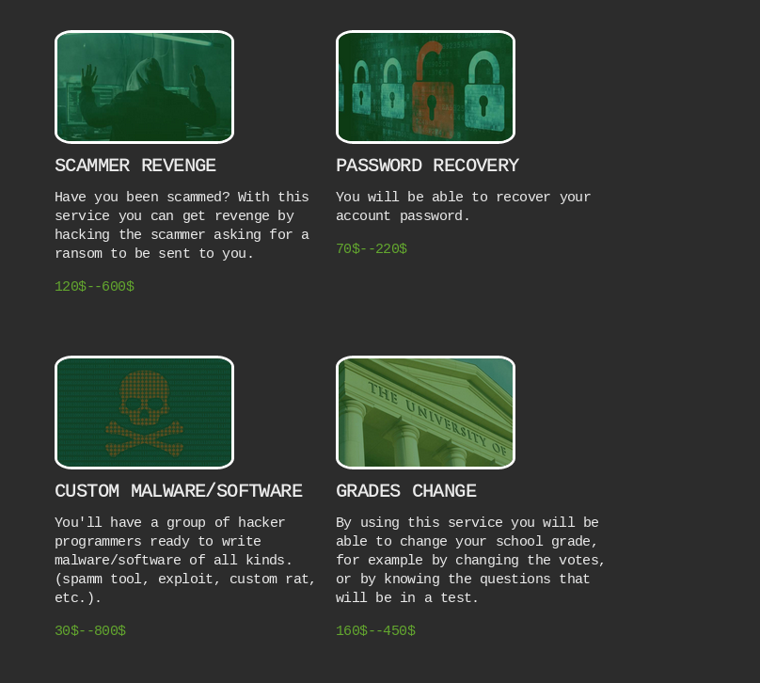
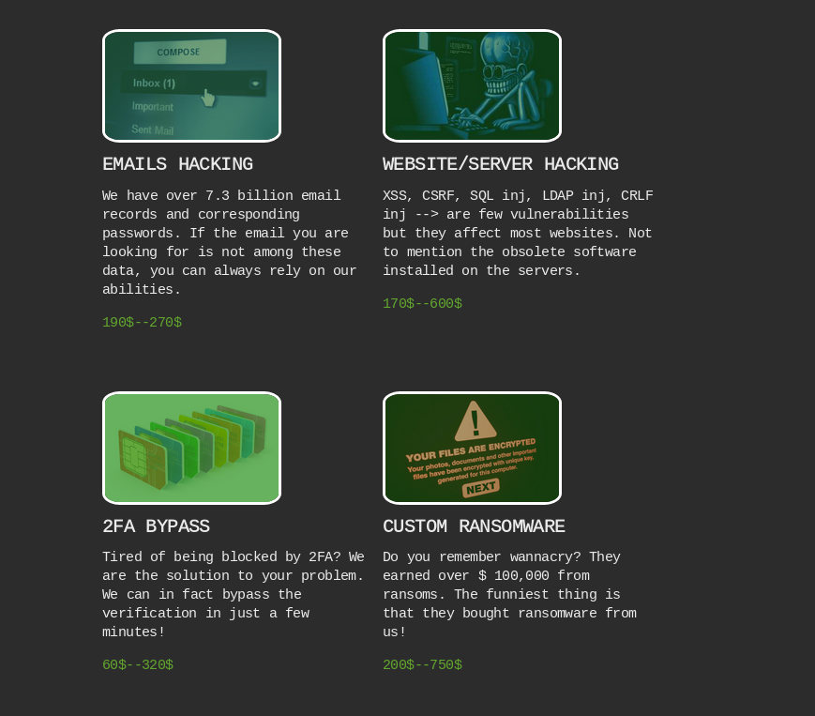
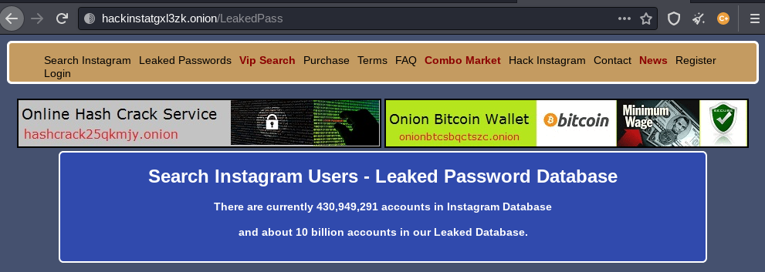
The Changing Landscape (Current Webpages)
Notes:
You Can now buy custom hacking custom ransomwares

Slide 8
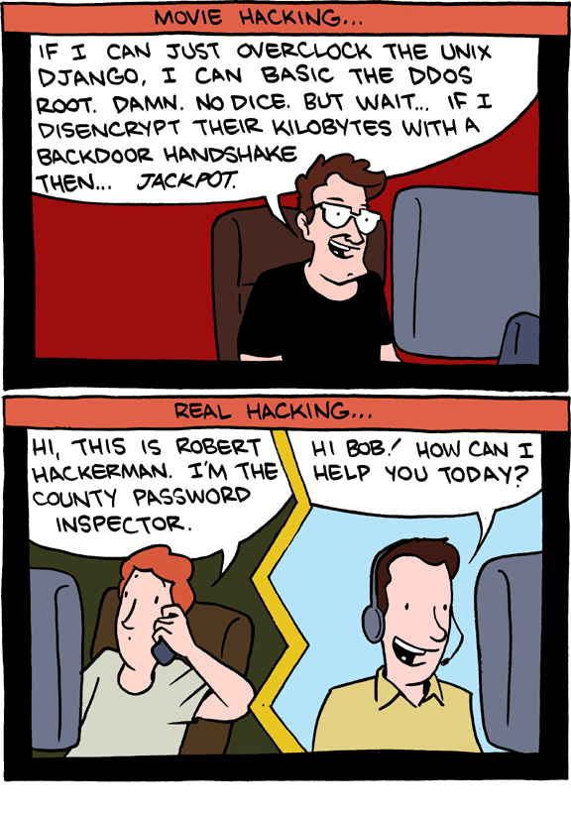
Threat Entry Points
Phishing
Ransomware
Connected Medical Devices (IoT)
Social Engineering
Misconfigured Servers
Inadvertent Disclosures
Unpatched Systems
Vendors and Business Associates
Facilities and other supporting systems
Internal Threats
Old Stuff!
https://www.techdirt.com/articles/20120306/15452818005/hollywood-hackers-vs-reality.shtml

Slide 9

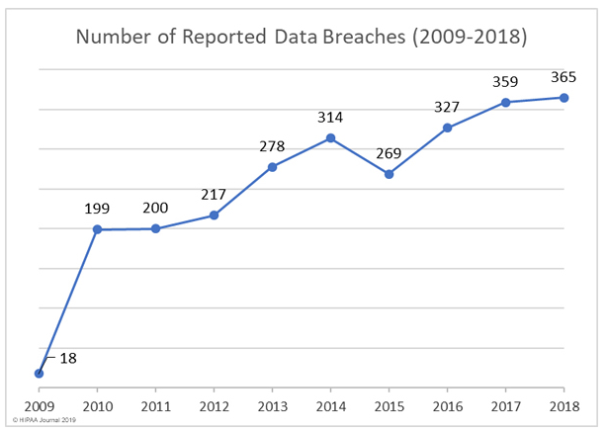

Maybe we are a Target?
2020 Major Breaches
Name: Trinity Health
Reported: 9/14/2020
Number of individuals affected: 3,320,726
Name: Inova Health
Reported: 9/09/2020
Number of individuals affected: 1,045,270
Name: Magellan Health
Reported: 6/12/2020
Number of individuals affected: 1,013,956
Name: Dental Care Alliance
Reported: 12/08/2020
Number of individuals affected: 1,004,304
Name: Luxottica of America
Reported: 10/27/2020
Number of individuals affected: 829,454
Name: Northern Light Health
Reported: 8/03/2020
Number of individuals affected: 657,392
Name: Health Share of Oregon
Reported: 2/05/2020
Number of individuals affected: 654,362
Name: Florida Orthopaedic Institute
Reported: 07/01/2020
Number of individuals affected: 640,000
Name: Elkhart Emergency Physicians
Reported: 05/28/2020
Number of individuals affected: 550,000
Name: Aetna
Reported: 12/22/2020
Number of individuals affected: 484,157
41% of Healthcare Organizations
have reported that they
experienced a breach
https://www.beazley.com/news/2019/beazley_breach_insights_february_2019.html
Notes:
https://unsplash.com/photos/S1Xl9Ag1PrQ
https://unsplash.com/photos/vw4-IpWQu94
https://unsplash.com/photos/nMyM7fxpokE

Slide 10
Health Insurance Portability and Accountability Act and Health Information Technology for Economic and Clinical Health (HITECH) Act’s
Merit-Based Incentive Payment System (MIPS)
of 1996 (HIPAA): required HHS to adopt national standards for electronic health care transactions and code sets, unique health identifiers, and security. At the same time, Congress recognized that advances in electronic technology could erode the privacy of health information. Consequently, Congress incorporated into HIPAA provisions that mandated the adoption of Federal privacy protections for individually identifiable health information.
To meet this measure, MIPS eligible clinicians must attest YES to conducting or reviewing a security risk analysis and implementing security updates as necessary and correcting identified security deficiencies
Healthcare Privacy & Security Regulations

Slide 11
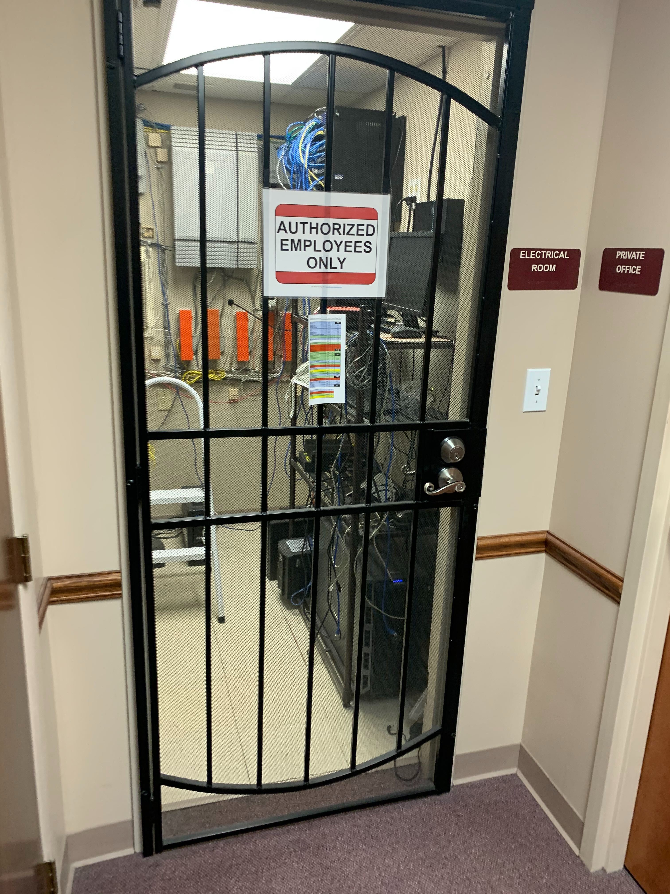
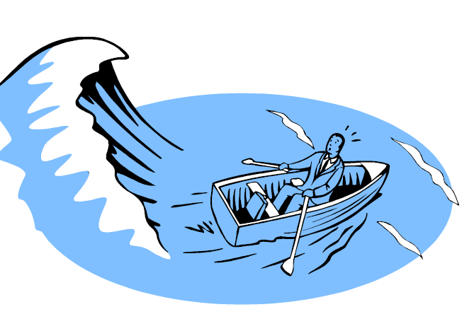
Risk
Risk can be defined as: “the net mission impact to the organization considering
The probability that a particular [threat] will exercise (accidentally trigger or intentionally exploit) a particular [vulnerability] and
The resulting impact if this should occur.
Notes:
“What are the chances something will happen and, assuming it does, what is the impact on our organization and patient care.

Slide 12
Security Risk Analysis/Assessment
Under the HIPAA Security Rule, you are required to:
Conduct an accurate and thorough analysis of the potential risks and vulnerabilities to the confidentiality, integrity, and availability of ePHI. Once you have completed the risk analysis, you must take any additional “reasonable and appropriate” steps to reduce identified risks to reasonable and appropriate levels.
(45 CFR 164.308(a)(1)(ii))

Slide 13
Review Tool

Slide 14
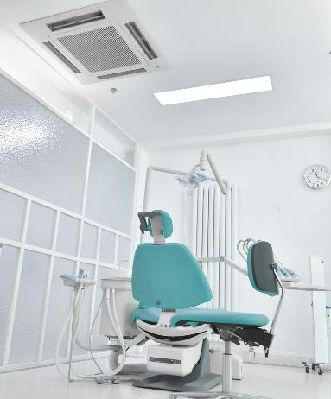
Security Risk Analysis
Requirement
Required by HIPAA Security Rule (45 CFR 164.308(a)(1)(ii))
Timing
Commonly conducted annually to track maturity and security enhancement. Many of the HIPAA requirements are determined by the risk to the organization
Risk
Analysis
Framework
Not required to, but recommend following an established framework such as NIST, COBIT, or ISO
Notes:
https://unsplash.com/photos/TtKpBUzta-M

Slide 15
Security Risk Analysis Challenges
01
03
  Organizations worry about enforcement actions if they acknowledge they have security risks
  It can be hard to understand requirements
Risk
Assessment
02
04
  It is hard to find concrete examples and expertise
  Many “risk assessments” end up being an enumeration of security controls or simple checklists

Slide 16
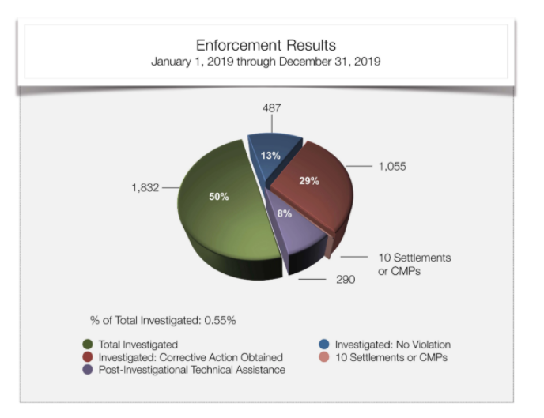
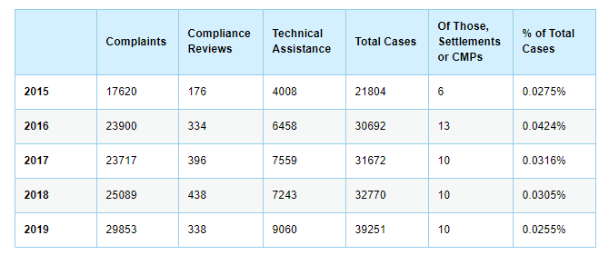
Enforcement

Slide 17
Compliance vs. Security
Security is not a product
Compliance is not your blueprint.
Security is a mindset.
Compliance
Security
Avoid checkbox compliance.
Security is an ongoing program
Remember “reasonable and appropriate”
Security is not just an IT responsibility.
Compliance is an ongoing requirement
Notes:
It is important to note that a risk assessment/analysis is not a compliance assessment.

Slide 18

Assessment/Analysis Approach
  The Security Risk Assessment approach is designed to allow organizations to implement “reasonable and appropriate” security controls as opposed to being prescriptive
  For example, what is a reasonable disaster recovery plan for a large health system would be excessive for a small doctor’s office; this allows flexibility while still being enforceable
  If other organizations of the same size are encrypting their laptops, it would seem reasonable to expect your organization to do the same
  But how can you determine what is “reasonable and appropriate” for your organization?
Take a Security Risk Management approach and look to industry standards and guidance

Slide 19
Security Risk Analysis/Assessment Process
Assess Current HIPAA Security Measures
Determine the potential impact of threat occurrence
Finalize Documentation
Data Collection
1
3
5
7
9
Define the Scope
Identify potential Threats and Vulnerabilities
Determine Likelihood of threat occurrence
Determine the Level of Risk
Periodic Review and Updates, Iterative
2
4
6
8

Slide 20
Security Risk Analysis, What does it look like
Is… | Is Not…
An evaluation of realistic threats to ePHI | A security checklist
A evaluation that includes technical, administrative, and physical safeguards | A vulnerability scan
A recurring or ongoing process | A one-time event
An administrative process | An automated task
Focused on ePHI | A general security evaluation

Slide 21
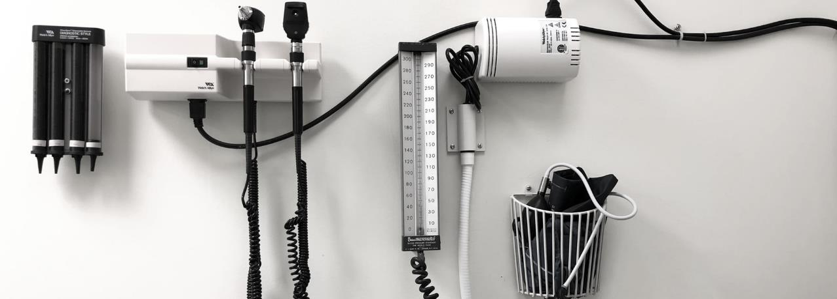
Myth or Fact
True or False: My EHR Vendor is HIPAA Compliant, so there is nothing else I need to do.
False. Your EHR vendor may be able to provide information, assistance, and training on the privacy and security aspects of the EHR product. However, EHR vendors are not responsible for making their products compliant with HIPAA Privacy and Security Rules. It is solely your responsibility to have a complete risk analysis conducted.
Notes:
https://unsplash.com/photos/Z3fXPuxa15k

Slide 22
Myth or Fact
True or False: I only need to perform a Security Risk Analysis once.
False. To comply with HIPAA, you must continue to review, correct or modify, and update security protections.
Under MIPS/MACRA, reviews are required for each reporting period.
(MACRA)The Medicare Access and CHIP Reauthorization Act of 2015 (MACRA) is a bipartisan legislation signed into law on April 16, 2015.
MACRA also required us to remove Social Security Numbers (SSNs) from all Medicare cards by April 2019.
Notes:
https://unsplash.com/photos/Z3fXPuxa15k

Slide 23
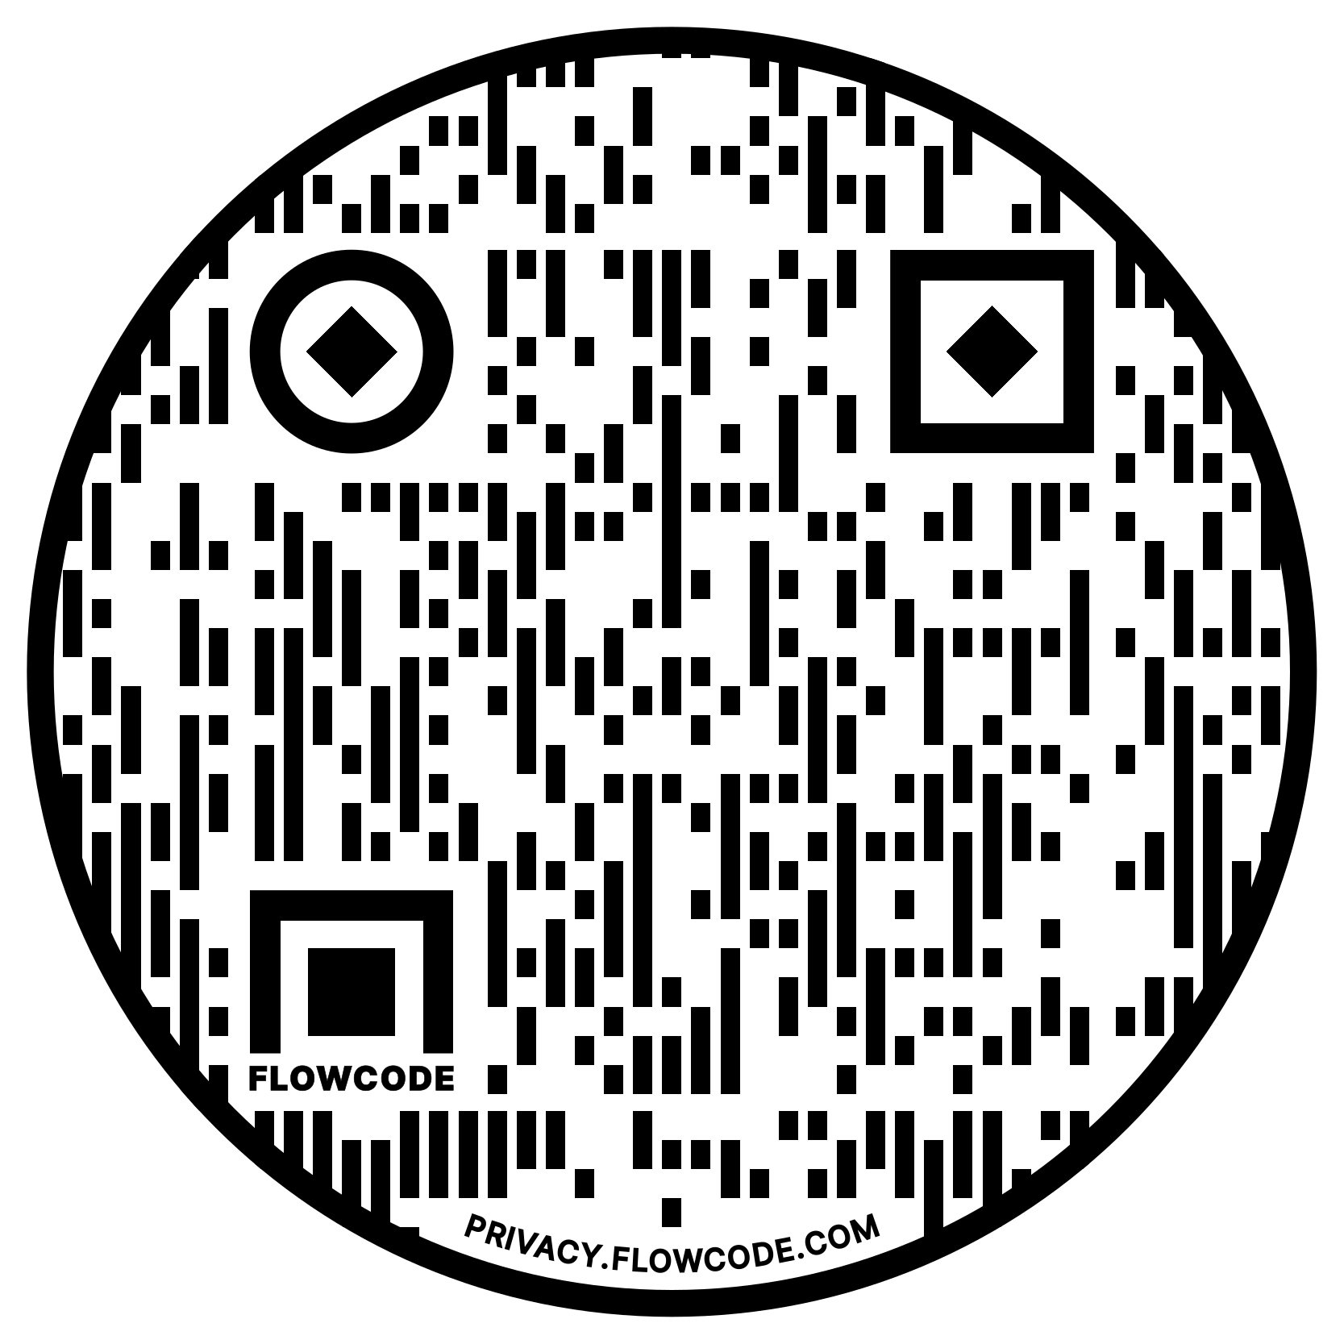
Thank You
Survey
Skobes@obsglobal.com

Slide 24
Resources
HealthIT.gov
  https://www.healthit.gov/topic/privacy-security-and-hipaa
The Office for Civil Rights
  Guidance on Risk Analysis Requirements under the HIPAA Security Rule
The National Institute for Standards in Technology (NIST)
  NIST SP 800-30 Guidance for Conducting Risk Assessments
  NIST SP 800-66 An Introductory Resource Guide for Implementing the HIPAA Security Rule
  HIPAA Security Rule Toolkit

