Slide 1

Boosting Outreach and Enrollment Strategies for NY Community Health Centers
June 4, 2025

Slide 2

HRSA Disclaimer
Portions of this initiative are supported by the Health Resources and Services Administration (HRSA) of the U.S. Department of Health and Human Services (HHS) as part of an award to CHCANYS’ New York State Primary Care Association (NYS-PCA) totaling $1,932,890. The contents are those of the author(s) and do not necessarily represent the official views of, nor an endorsement, by HRSA, HHS, or the U.S. Government. For more information, please visit HRSA.gov.

Slide 3

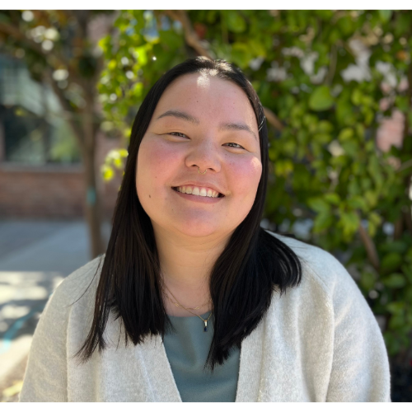
Facilitators
Smruti Shah
Deputy Director
Jing Murray
Program Manager

Slide 4
Health Outreach Partners
WE SUPPORT HEALTH OUTREACH PROGRAMS by providing training, resources, consultation, workshops, and webinars.
OUR MISSION: We respond to community needs by equipping health partners with relevant, strategic knowledge and tools to transform communities from the ground up resulting in a healthy and equitable society.
WE SERVE Community Health Centers, Primary Care Associations, and Safety-net Health Organizations.

Slide 5
Welcome and Overview
Notes:
.

Slide 6
Learning Objectives
Participants will learn strategies, best practices, and metrics for success for their outreach and enrollment programs.
Participants will analyze methods for building and leveraging community partnerships.
Participants will understand how to support the business case for effective outreach programs.

Slide 7
New York State Landscape

Slide 8
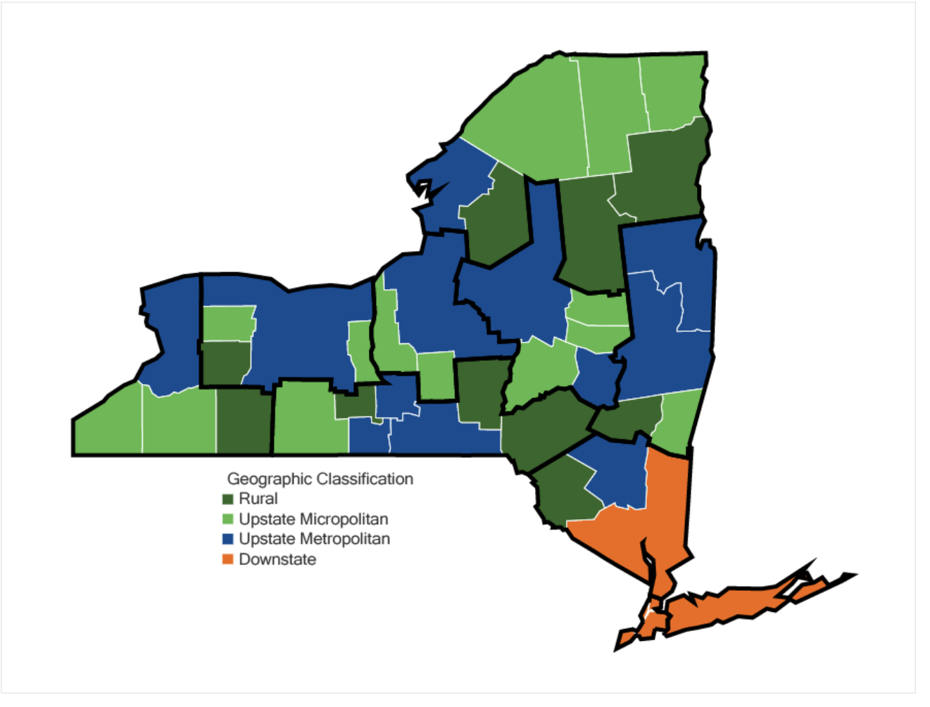
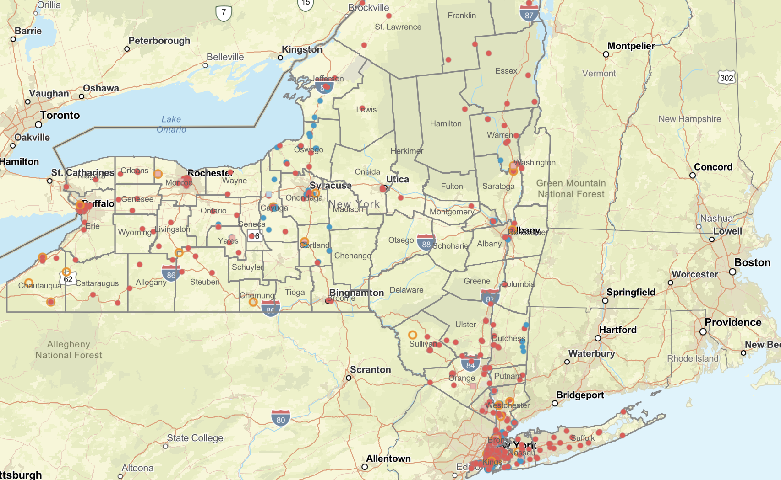
Where are New York State Community Health Centers?
Source: https://rockinst.org/blog/introducing-new-yorks-rural-economies/
Source: https://chcanys.maps.arcgis.com/apps/instant/basic/index.html?appid=b9340db6a9b14048b4bddc3c5326bb90

Slide 9
Data highlights : Health-related challenges in rural NY
Provider Shortages
  70% of rural counties lack adequate access to mental health providers
Transportation Barriers
  Limited public transportation options make it difficult for residents to access healthcare facilities, especially for older adults and individuals with disabilities
Digital Divide
  25% of rural households lack reliable internet for telehealth
Food Security
  Food insecurity rates exceed 15% in some rural NY counties
Chronic Disease
  Rural residents are 40% more likely to have unmanaged chronic diseases
Sources:
Steptwopolicy
State Comptroller Report, 2023

Slide 10
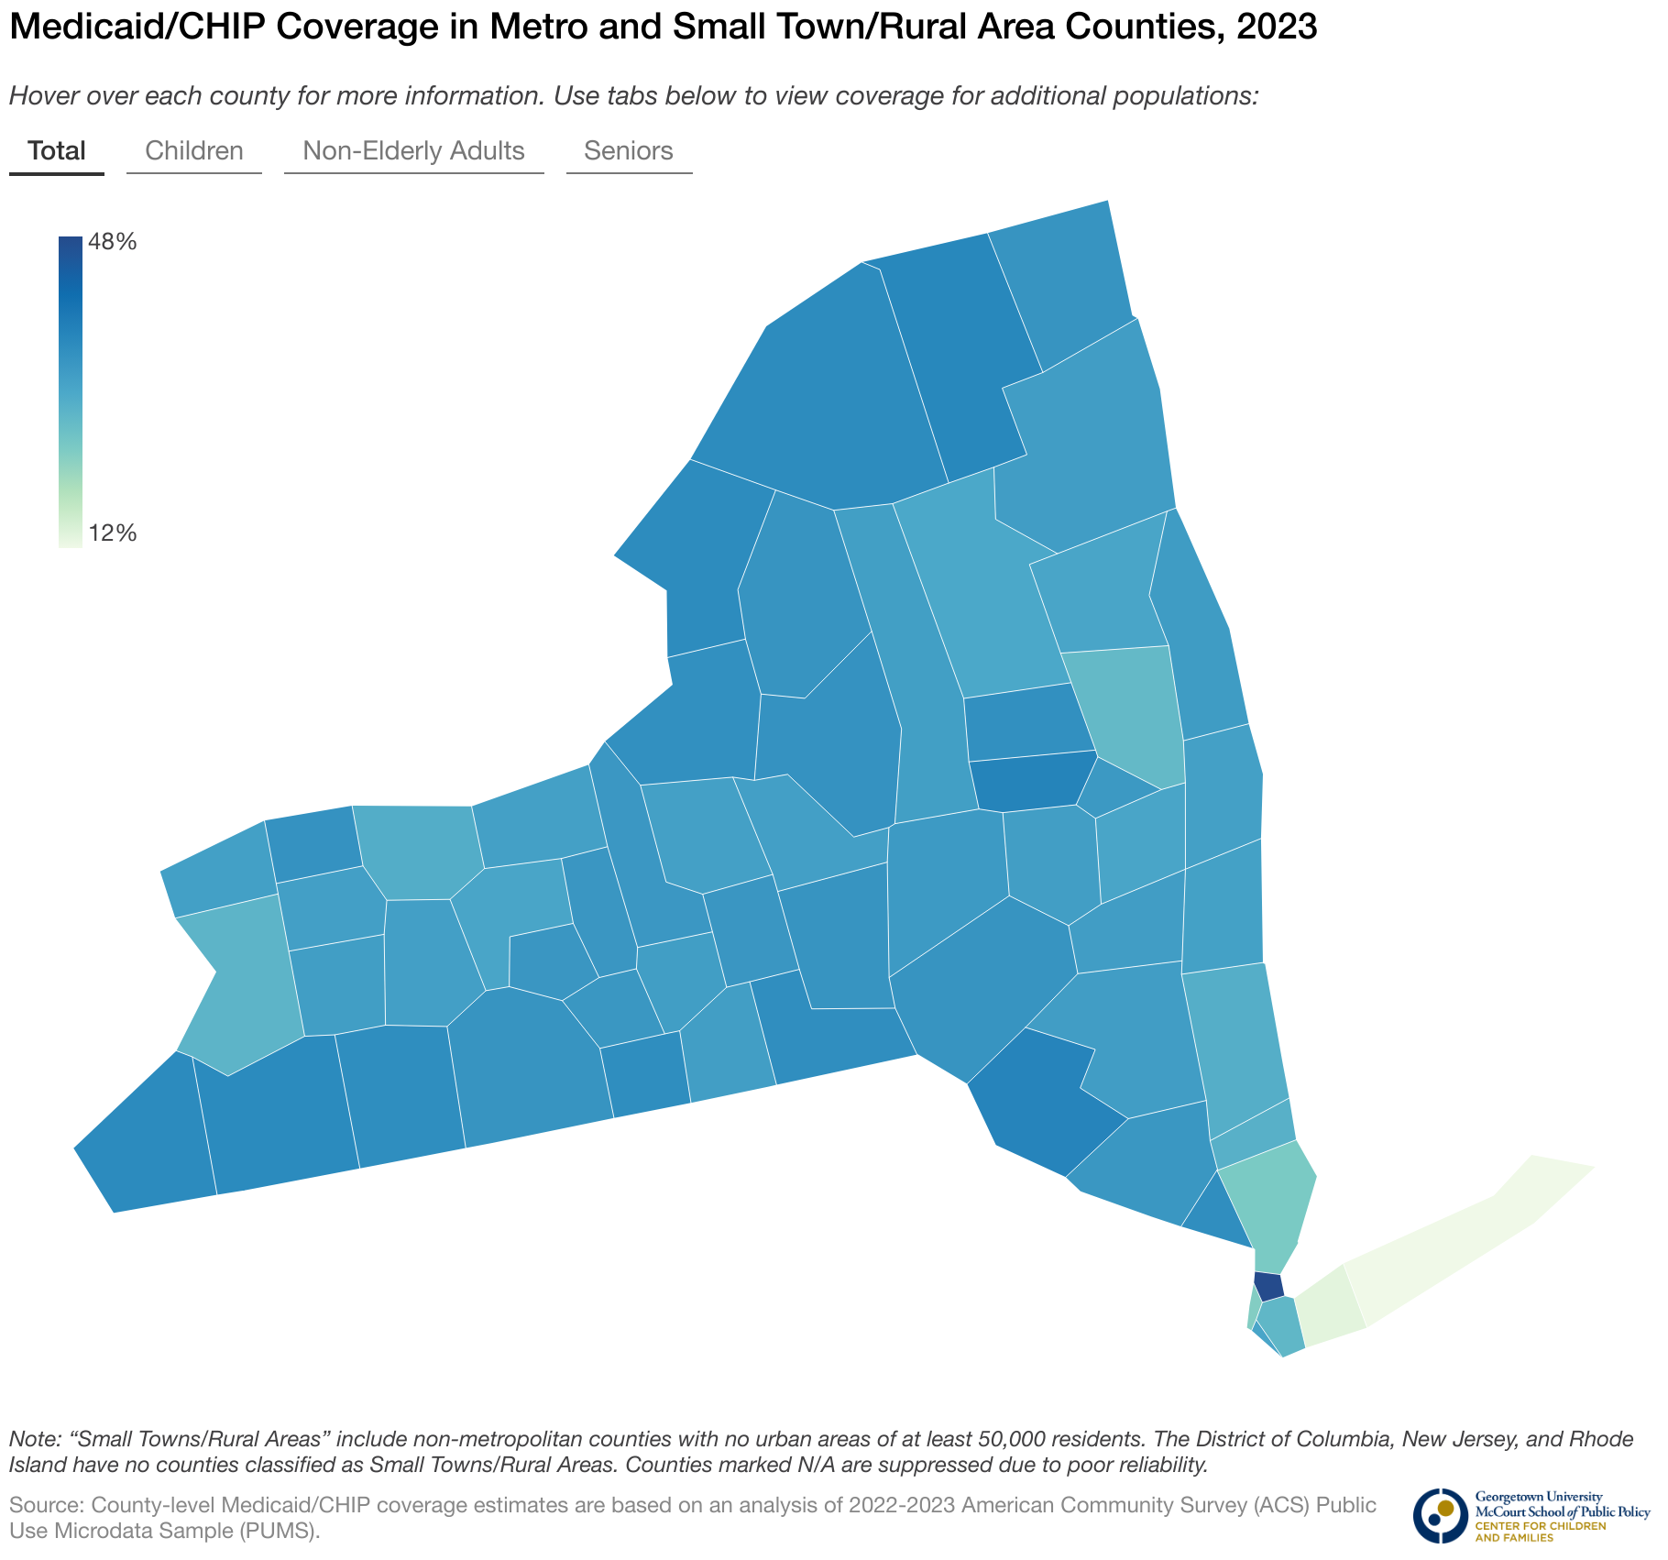
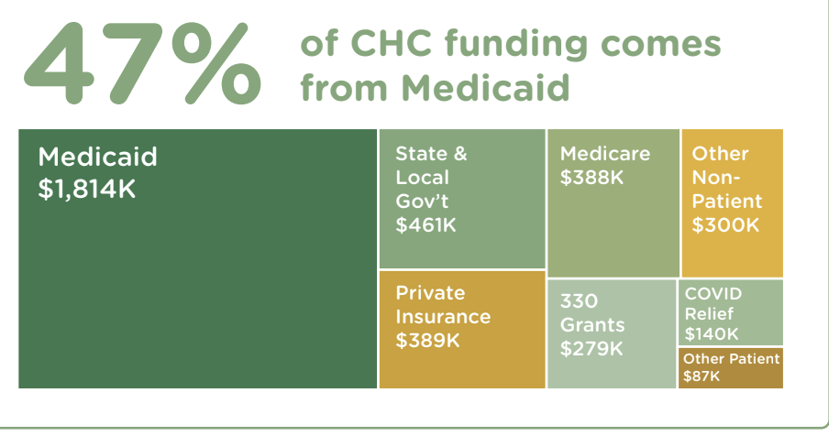
New York State: Medicaid CHIP coverage 2023
Source: CHCANYS
NY State coverage is at an average 34.5%
Support for Community Health Centers (CHCs): New York has 63 CHCs operating across 831 service sites, with 17% located in rural areas. These centers depend heavily on Medicaid and federal grants to sustain operations, serving as critical access points for primary care, behavioral health, and preventive services. ​geigergibson.publichealth.gwu.edu

Slide 11
Impact of Medicaid Enrollment in Rural New York
High Enrollment Rates
Improved Health Outcomes
CHC Enhanced Service Delivery
Financial Stability
Addressing non-clinical health needs
Sources: ​
geigergibson.publichealth.gwu.edu
National Rural Health Center For Children and Families

Slide 12
What is Outreach and who makes it work

Slide 13
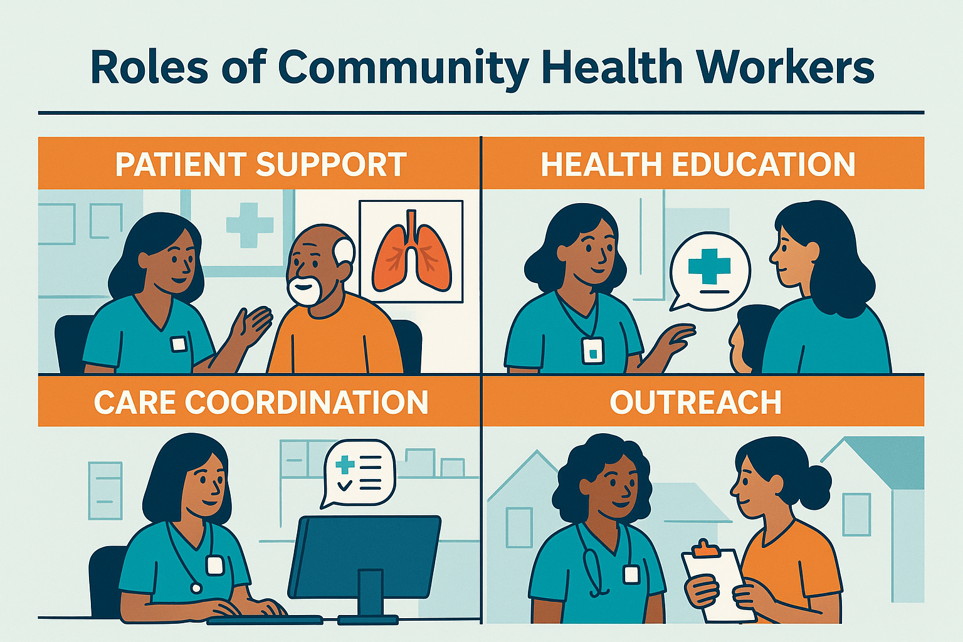
Who is a Community Health Worker?
Titles (can) include: Promotoras, Patient Navigator, Community Outreach Staff, Frontline Staff
CHWs play a vital role in reaching isolated populations, addressing transportation barriers, and linking patients to care and social services.
CHWs are on the front lines helping patients understand, apply for, and stay enrolled in Medicaid.
Source: https://nvchwa.org/who-are-community-health-workers-chws/

Slide 14
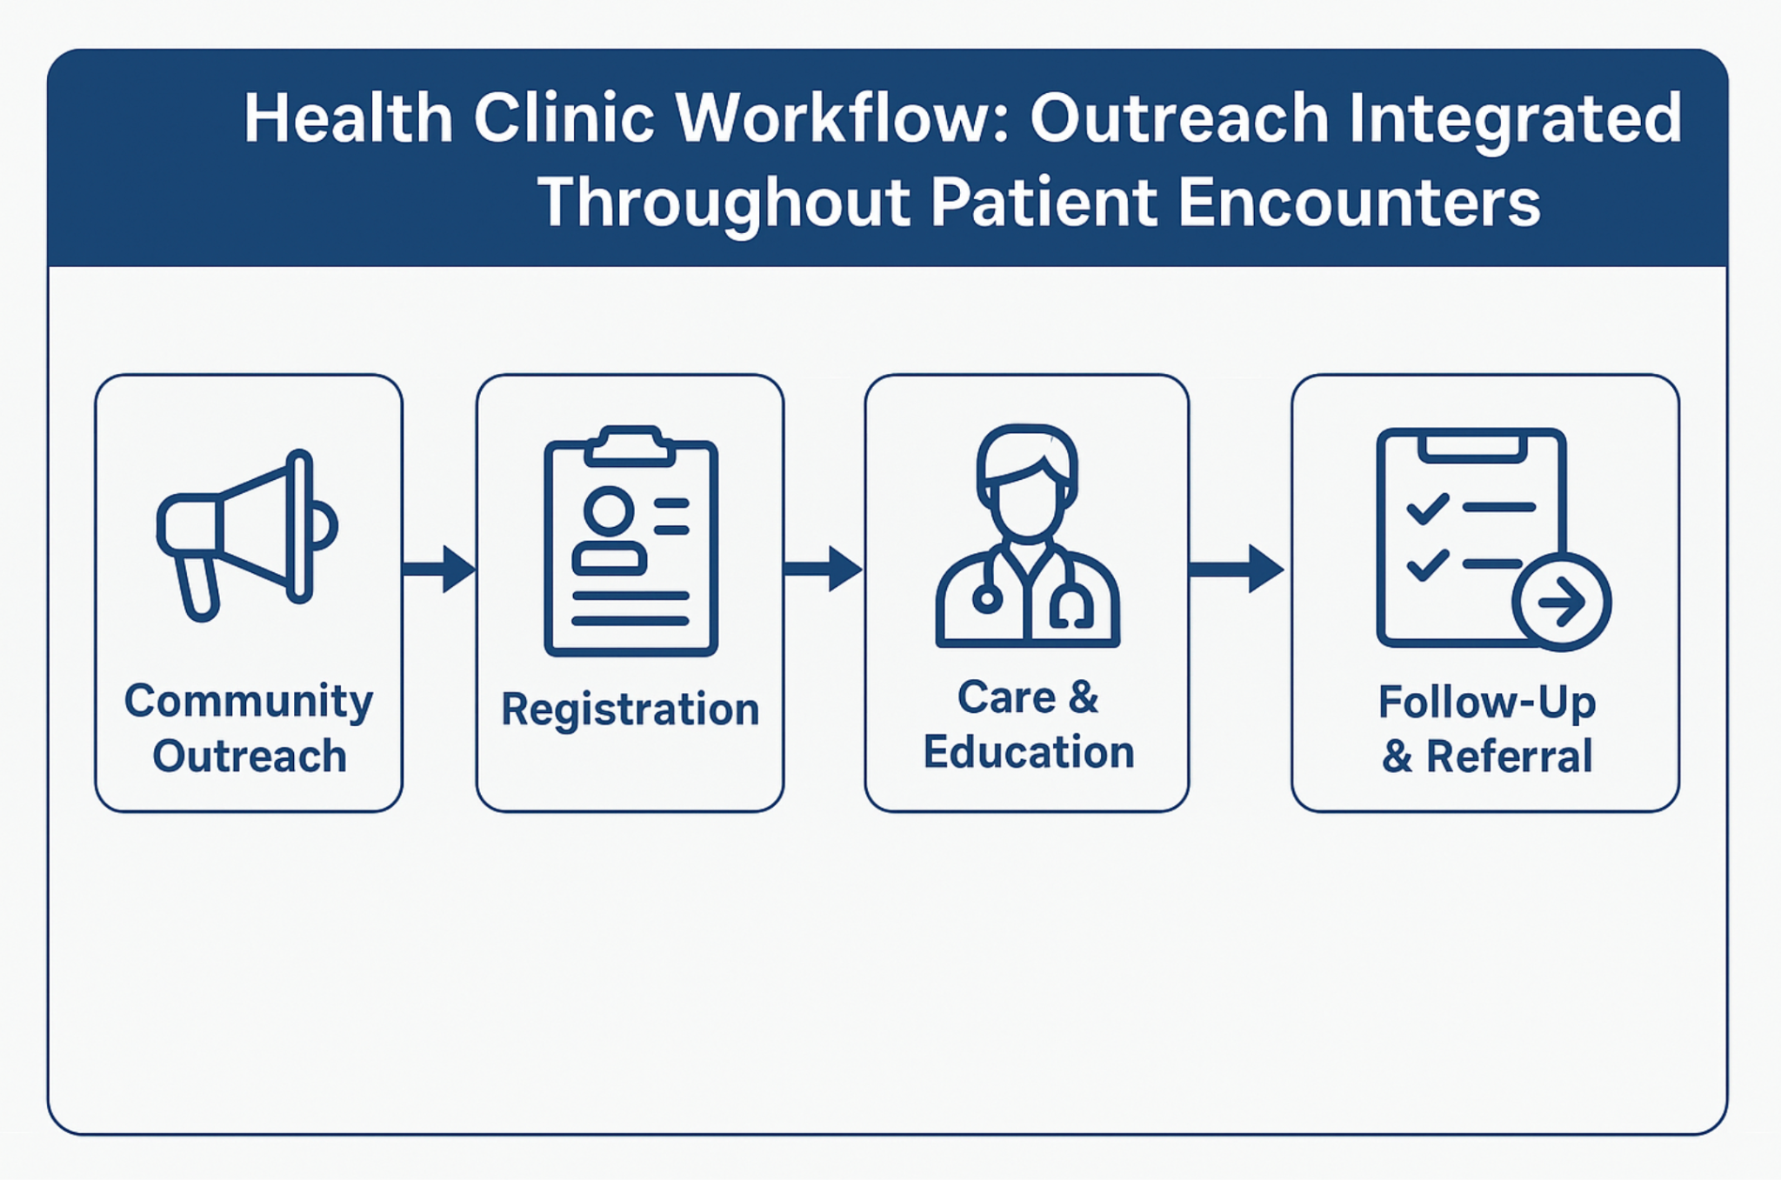
Designing an Effective Workflow for Outreach

Slide 15





5 Rights Workflow Adaption
The Right Information (What)
The Right Format (How)
The Right Person (Who)
The Right Channel (Where)
The Right Time (When)
Source: https://prapare.org/prapare-toolkit/

Slide 16
The Right Information
The “What”
Guidelines
Policies

Slide 17
The Right Format
The “How”
Social Media
Community Events
Mobile Units

Slide 18
The Right Person
The “Who”
Community health workers
Nurses
Doctors

Slide 19
The Right Channel
The “Where”
Seasons
Meeting community where they are at

Slide 20
The Right Time
The “When”
Seasons
Regular meeting places

Slide 21


Slide 22
Boosting Outreach through Smarter Strategies

Slide 23
Principles for Improving Outreach
Use multiple strategies
Be creative
Use multiple strategies
Be flexible
Be flexible
Evaluate
Be flexible
Effective Outreach
Evaluate

Slide 24

Field Tested Approaches
Partner with Community-Based Organizations (CBOs)
Leverage local knowledge
Use Mobile Enrollment Units
Offer Remote Enrollment Options
Launch Targeted Marketing Campaigns
Provide Incentives
Collaborate with Local Institutions

Slide 25
Challenges in outreach.......
Geographic Isolation
Limited Broadband and Technology Access
Workforce Shortages
Complex or Changing Eligibility Rules
Resource Limits

Slide 26
….and some Practical Solutions
Long distances → Use mobile units, cluster outreach events
    Poor broadband → Offer paper-based or in-person enrollment
    Small staff → Partner with local orgs, share outreach roles
    Community trust → Be consistent, show up regularly
    Few resources → Build referral lists, connect regionally
    Outreach fatigue → Rotate tactics, use community input

Slide 27
Summary
Successful Outreach in rural areas involves:
    Building trust through a local presence
    Tailoring outreach to rural realities
Knowing resources and gaps
Fostering Cross-sector partnerships
Focusing on relationships
Using appropriate materials
Tracking Impact and Adapting

Slide 28
Community Outreach Plan

Slide 29
Community Outreach Plan
Step 1: Needs & Assets Assessment
Step 3: Building Community Partnerships
Step 2: Community Mapping

Slide 30
Needs & Assets Assessment
Step 1: Needs & Assets Assessment
Step 3: Building Community Partnerships
Step 2: Community Mapping

Slide 31








Needs & Assets Assessment
Preferred languages
Different backgrounds
Online presence
Communication channels
Communities or social groups
Employment
Health needs or concerns
Trusted leaders or professionals

Slide 32
Community Mapping
Step 1: Needs & Assets Assessment
Step 3: Building Community Partnerships
Step 2: Community Mapping

Slide 33
Community Mapping
A visual tool to identify people, organizations, and resources in your community
Helps us understand who’s doing what—and where the gaps are
Strengthens referral networks and care coordination

Slide 34
Why Community Mapping?
Improves patient outcomes by addressing social needs
Reveals untapped partnerships
Helps prioritize outreach and collaboration

Slide 35
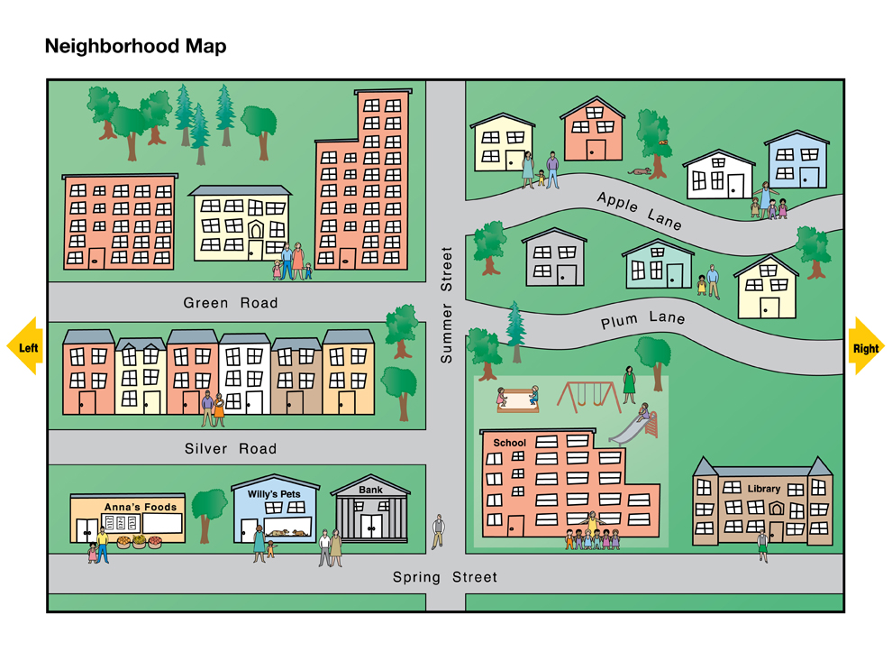
Community Mapping
Faith-based organizations
Community centers
Cultural centers
Local libraries
Housing sites
Parks
Health & social service agencies
Schools & school district offices
Farms & warehouses
Places of employment
Grocery stores
Laundromats

Slide 36
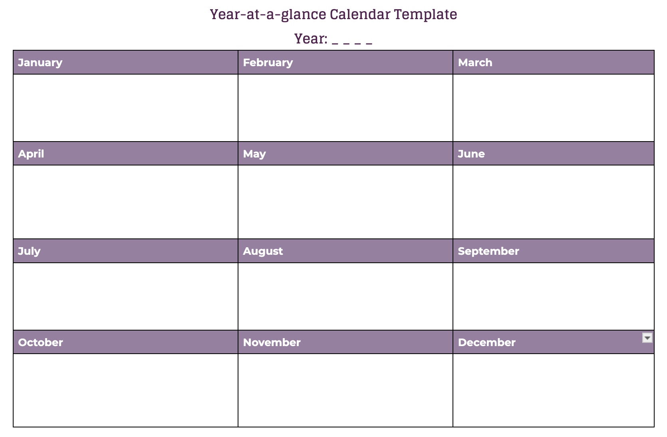

Slide 37
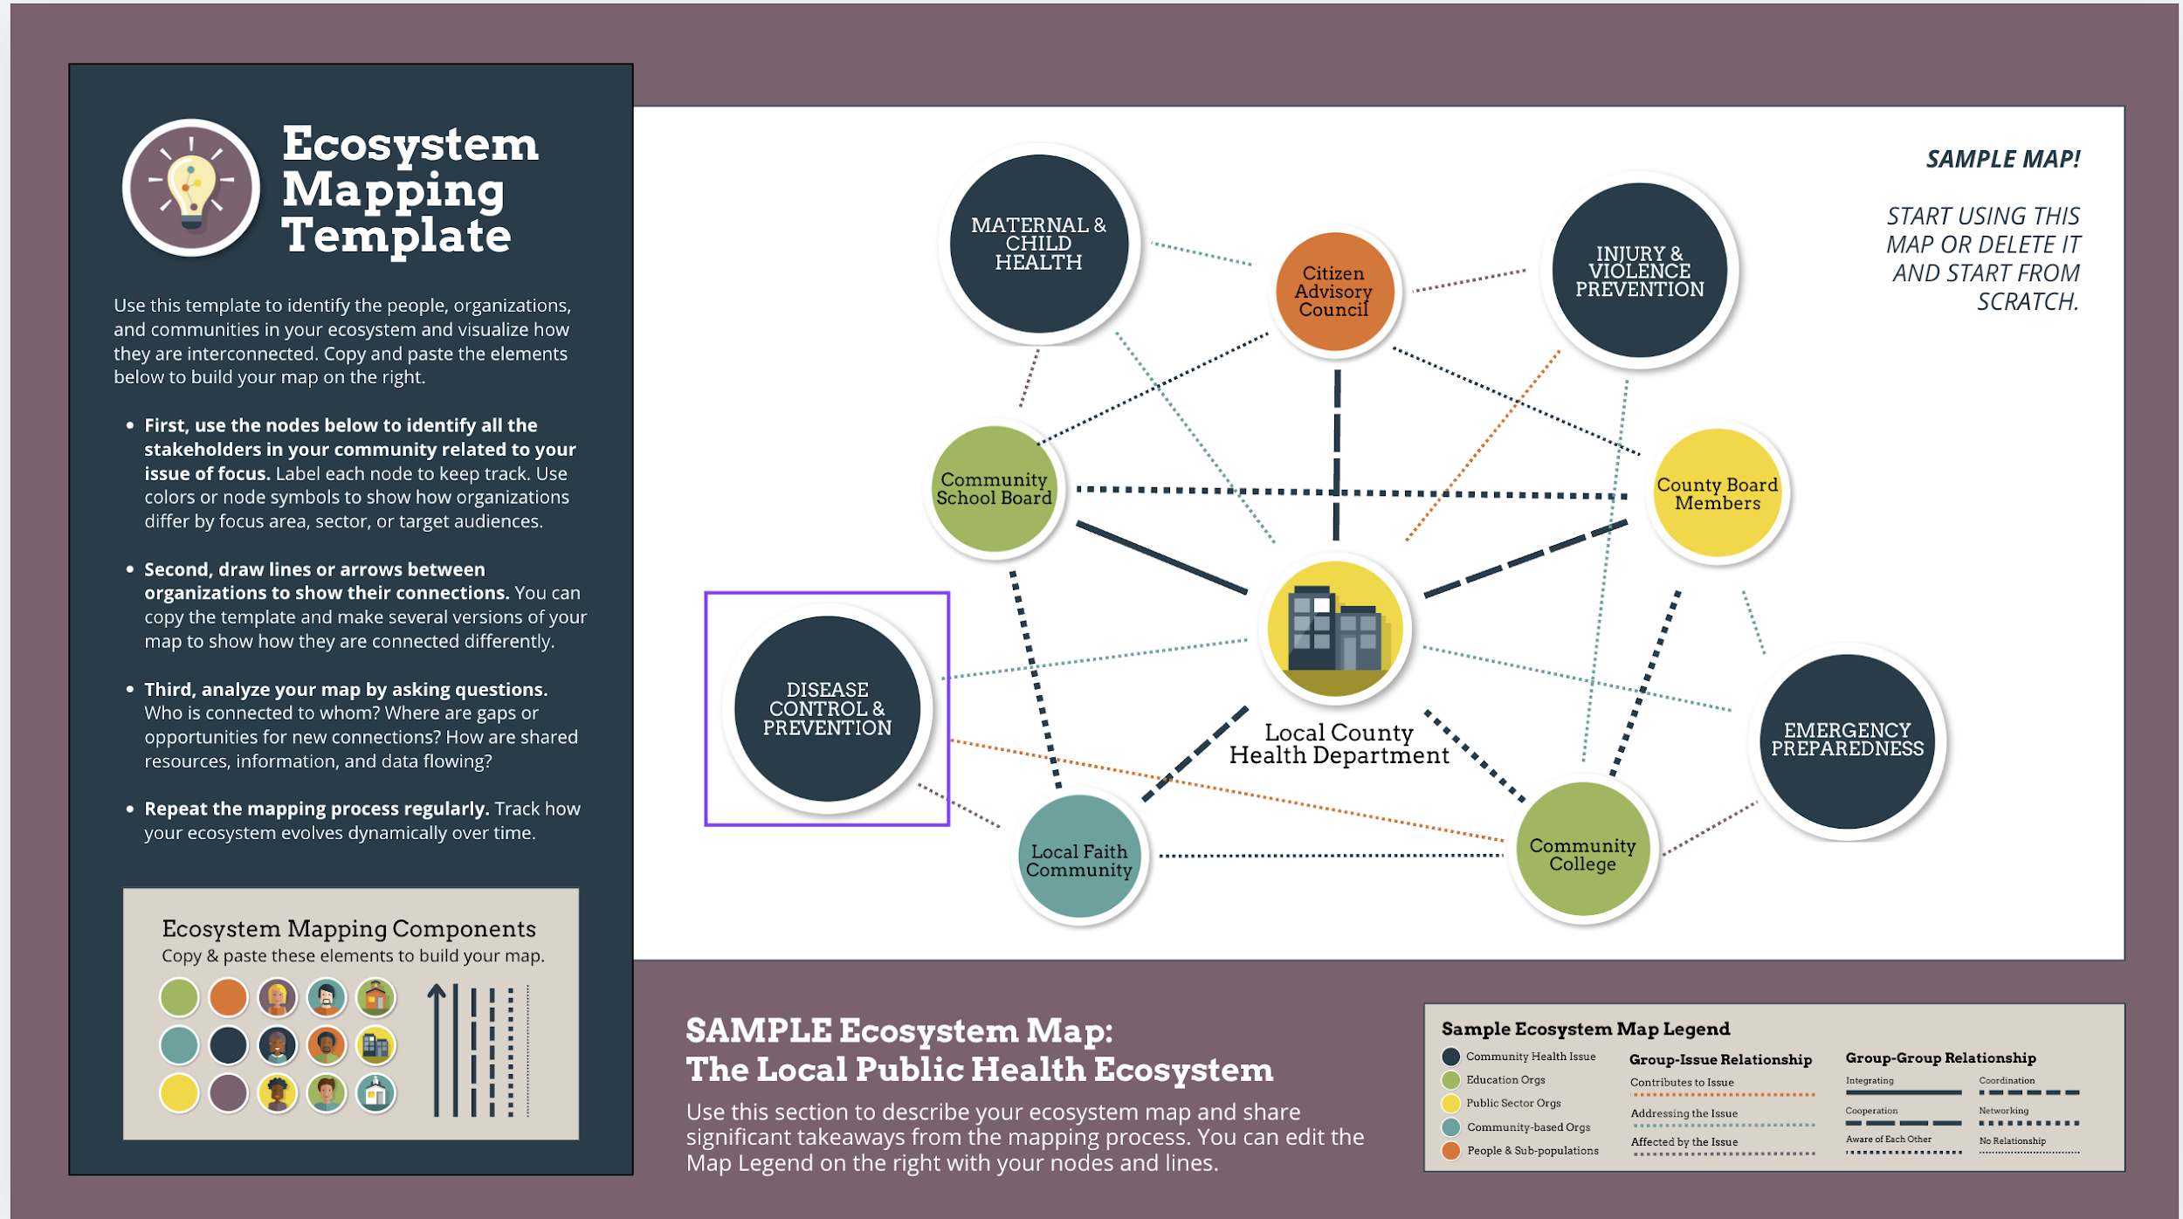
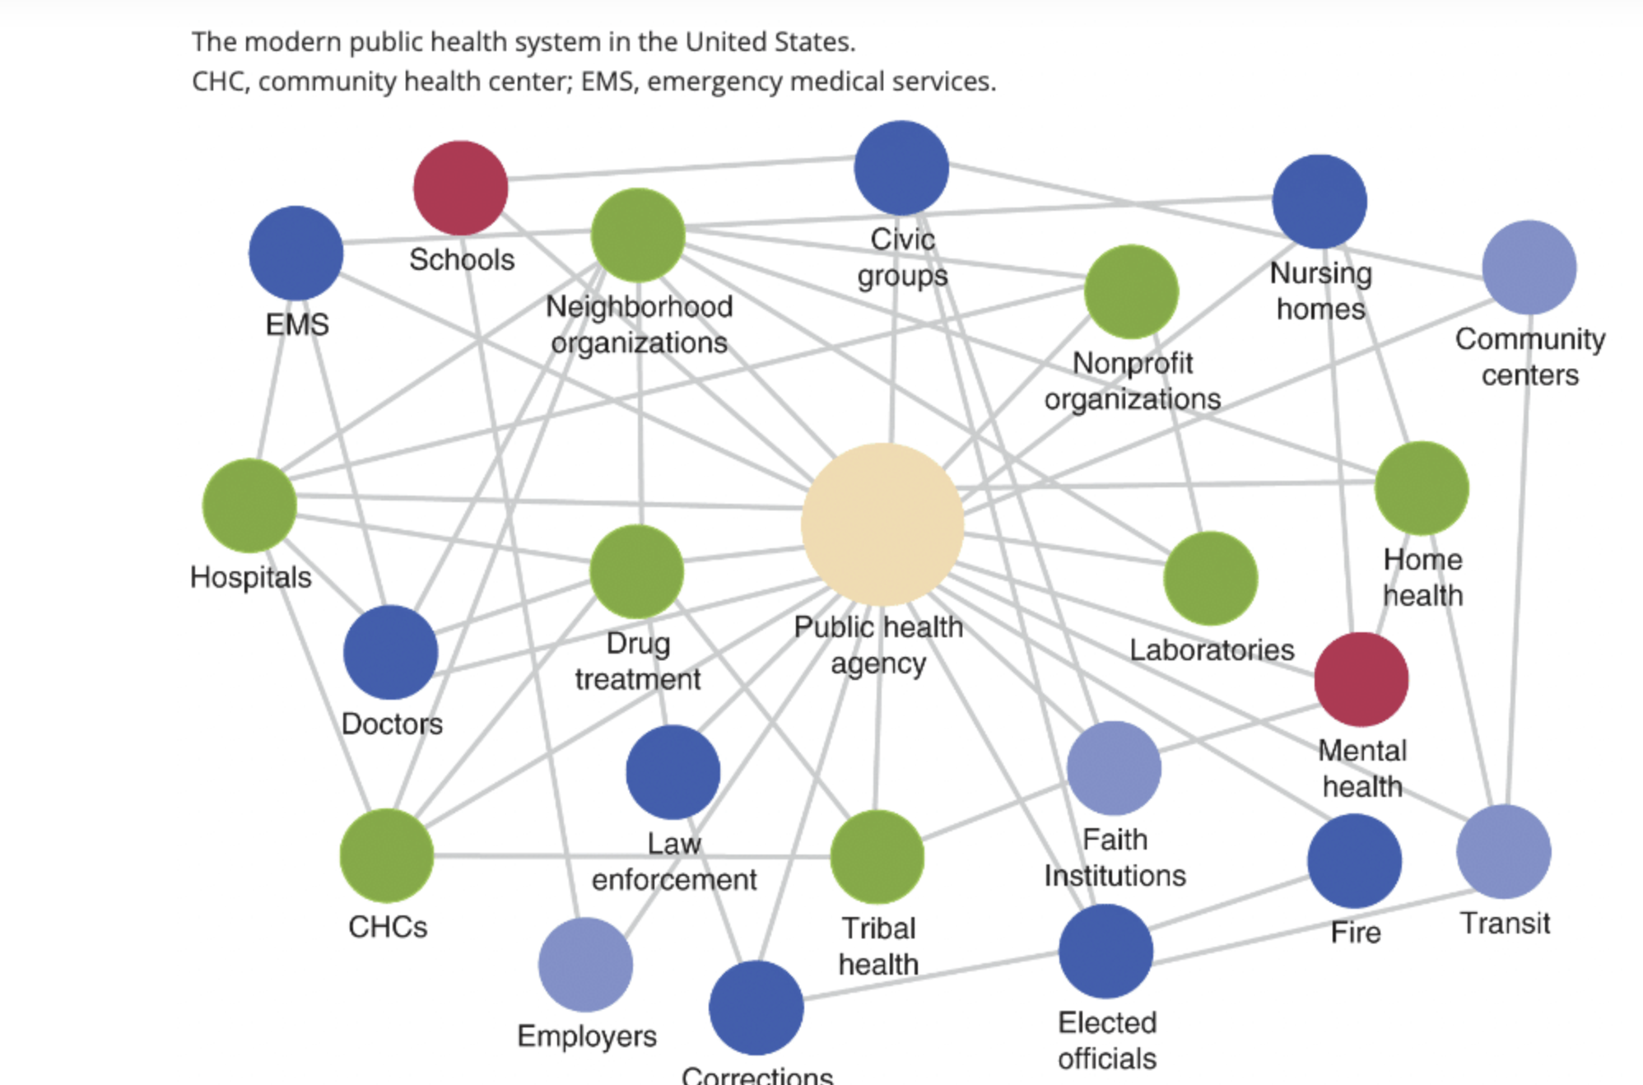
Community Mapping Resources

Slide 38
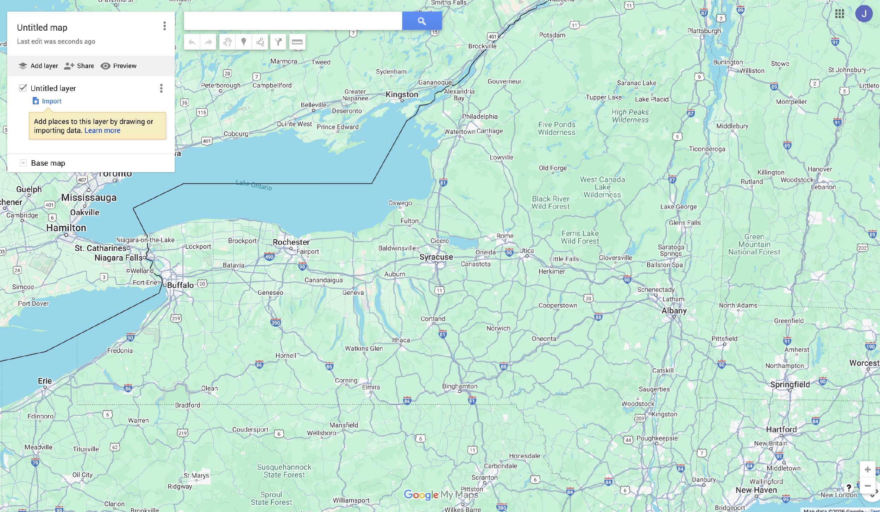
Community Mapping Resources
Low Tech Resources:
Physical Mapping
-Paper Maps
-White Boards
-Stick Notes/Color Coding
Digital Mapping Platforms
Google My Maps
Kumu
Mural
Miro

Slide 39
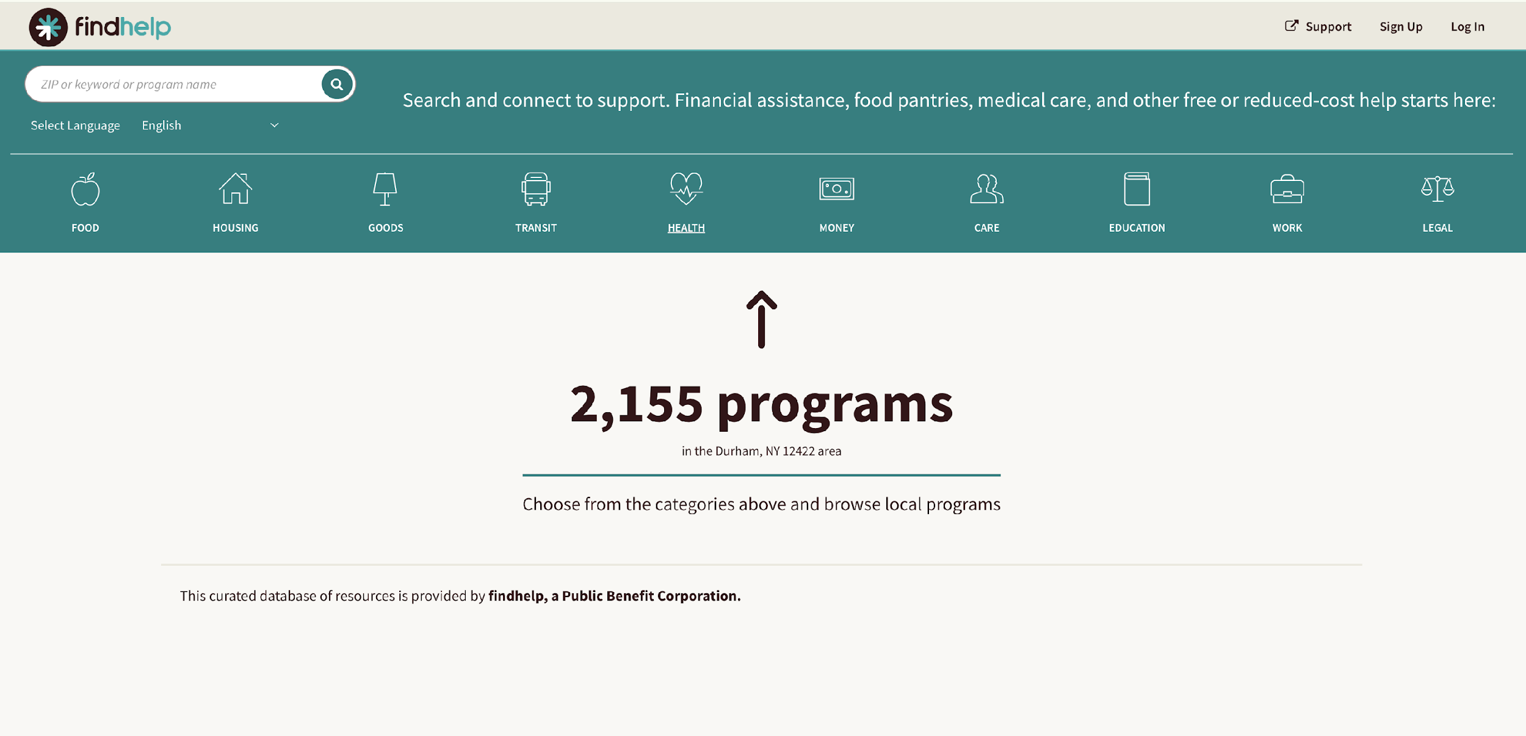
Community Mapping Resources
Data Driven Tools
  -Findhelp.org
  -Unite Us
  -ArcGIS
  Community Asset Inventories
  Spreadsheet or databases that list:
    -Organization names
    -Contact Info
    -Services offered
    -Target populations
    -Referral procedures
Source: https://findhelp.org/

Slide 40
Building Partnerships
Step 1: Needs & Assets Assessment
Step 3: Building Community Partnerships
Step 2: Community Mapping

Slide 41
Partnerships
Partnerships can:
Expand our knowledge/skillset/expertise
Increase resources ($, time, staff, etc.)
Improve visibility of a cause/goal
Expand our reach (reaching a broader audience

Slide 42
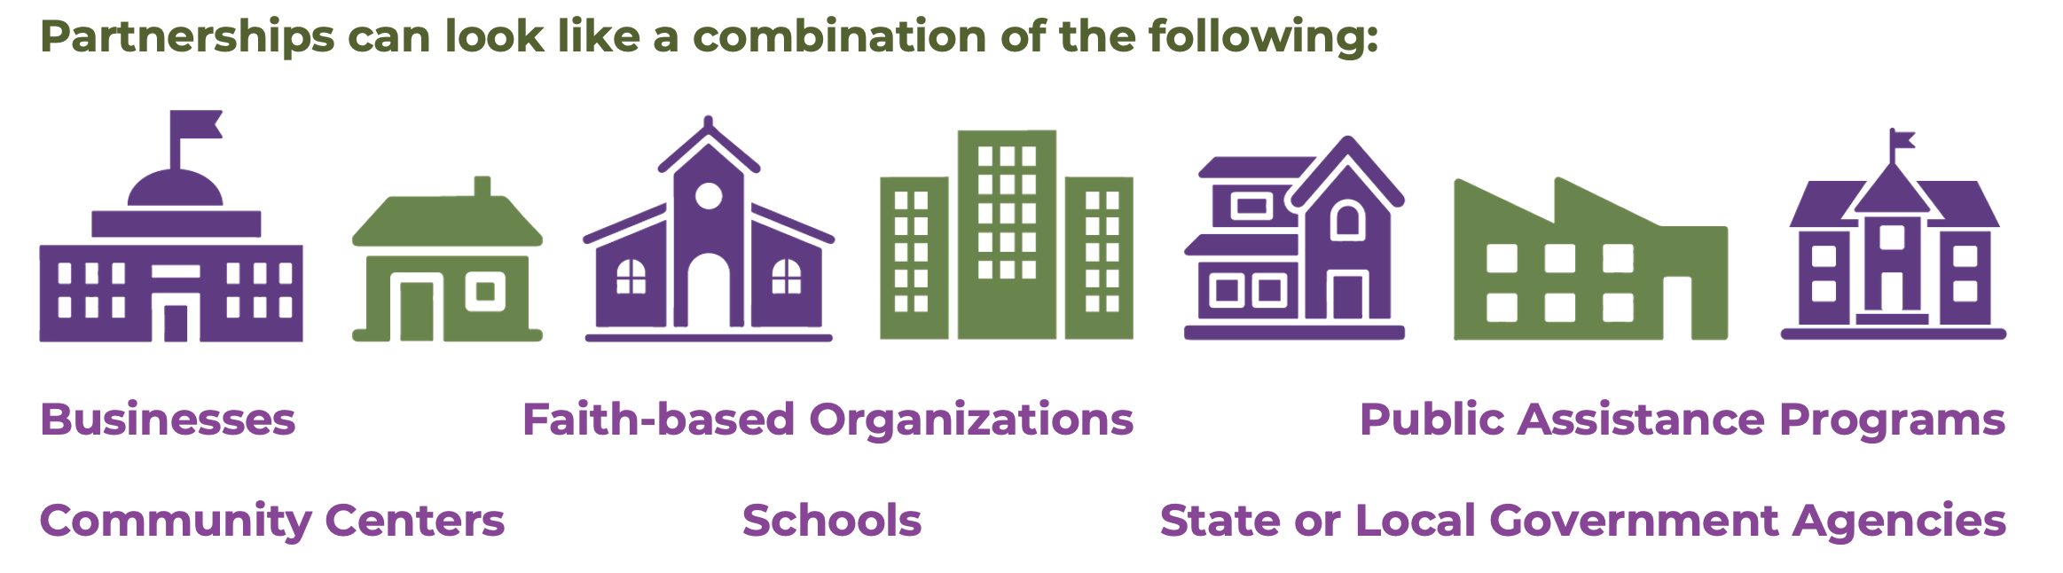
Building Partnerships

Slide 43
Collaborative Relationships
Collaborative Relationships provide the opportunity for organizations to work together towards a common goal or purpose
Notes:
​

Slide 44
Collaborative Relationships
1. Health Center + Local Food Bank (Formal Partnership)
Description: An FQHC signs an MOU with a regional food bank to run a permanent on-site pantry.
Shared Deliverables: Health center provides space and referrals; food bank supplies inventory and staff.
Outreach Impact: Screens patients for food insecurity (Z59.4), integrates food assistance into care plans.
2. Health Center + Medicaid Managed Care Plan
Description: A health center partners with a Medicaid insurer for patient outreach and engagement.
Shared Goals: Increase preventive care visits and reduce ED use.
Benefits: Shared data systems, joint patient navigation, and co-funded outreach events.
3. Health Center + Local Housing Authority
Description: Formal partnership to prioritize homeless patients for housing placements.
Impact: Enables coordinated case management and wraparound care for high-risk populations.
Collaboration Examples (Informal, Flexible, Short-Term)
1. Health Center + Faith-Based Organization
Description: A health center joins a community church’s weekend health fair.
Nature: One-time event offering screenings and insurance enrollment help.
Outcome: Builds visibility and trust with hard-to-reach populations.
2. Health Center + School Nurse
Description: A local school nurse refers uninsured students to the health center for back-to-school physicals.
Informal Agreement: No formal data sharing or contract—just mutual awareness and shared purpose.
3. Health Center + Library
Description: Monthly drop-in outreach table at the public library.
Purpose: Help people understand insurance options, hand out health flyers.
Strength: Low-cost, community visibility, good for testing outreach messages.

Slide 45
Partnerships
What Partnerships You Already Have?​
What New Partnerships Do You Need?
How Will I Network with These Partnerships?

Slide 46
Partnership Agreements
Contracts
MOUs
Agreements
Usually legally binding, created for business purposes, or to ensure the safety of one’s assets
Based on relationships
Can be both legally binding or non legal

Slide 47
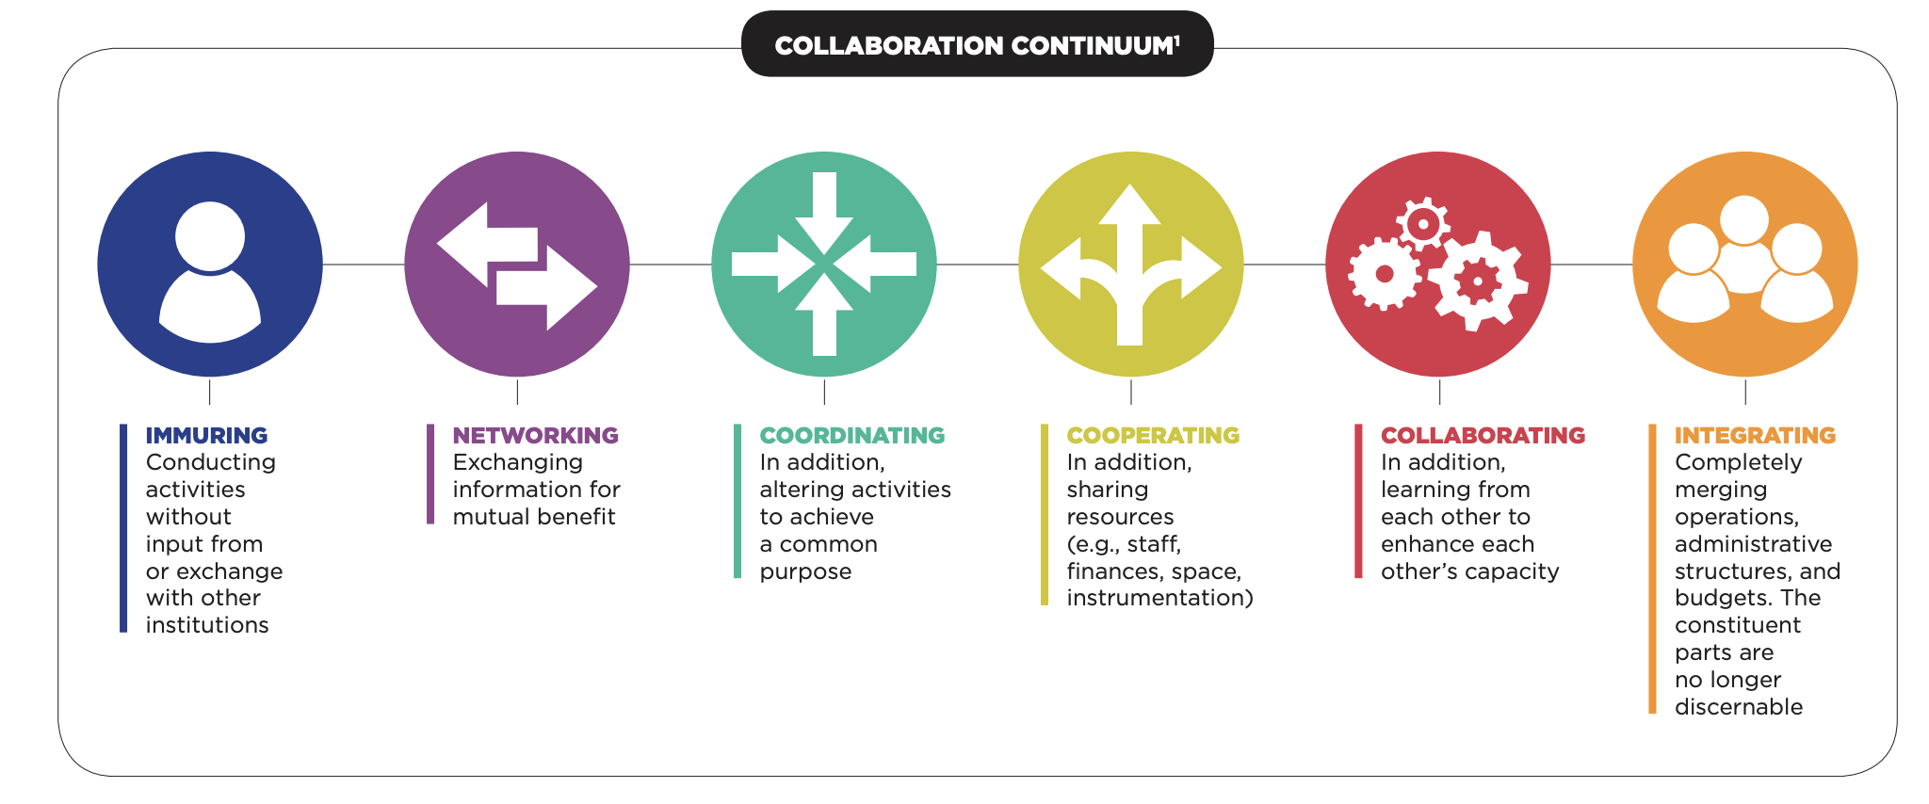
The Collaboration Continuum
Source: https://www.teaglefoundation.org/Teagle/media/GlobalMediaLibrary/documents/resources/CollaborationContinuum.pdf?ext=.pdf

Slide 48
Measuring Outreach Success and Return on Investment

Slide 49
Importance of measuring success
Demonstrates impact: Shows how outreach leads to real outcomes
Supports funding: Provides ROI for funders and leadership
Improves strategy: Helps refine targeting and follow-up
Aligns with access goals: Reduces barriers to care
Builds accountability: Sets benchmarks for staff and partners

Slide 50

Strategies for evaluating and measuring success
Quantitative Metrics
Qualitative Metrics
Tools/Dashboards
Return on Investment Calculations

Slide 51

Quantitative Metrics: How do we measure if outreach efforts are successful?
Access & Reach:
# of individuals screened, reached or enrolled
# and % enrolled and Increase in service utilization
Number of outreach events
Enrollment rates by outreach method (e.g., events, mobile units)
Geographic distribution of outreach success
Efficiency:
Time from outreach to enrollment
Engagement:
Follow-up rates
Referral completions
Retention or Renewal:
Referral completion rates
Repeat service use or return visits
Geographic distribution of outreach success

Slide 52

Qualitative Measures- Stories and observations
Patient testimonials or success stories
Improved access or understanding
Staff reflections on workflow or community impact
Focus on meaning

Slide 53

Tools and Methods
Before/after comparisons
Dashboards (coverage, payer mix, no-shows)
Cost-benefit models
Outreach efficiency: Hours spent on Outreach vs. Outcomes
Examples of common software platforms to:
Document outreach activities, enrollment outcomes through Electronic Health Records (EHRs) with CHW/Outreach Modules (Epic, eClinicalWorks, NextGen)
Log visits, outreach texts, follow-ups (Care Message, Salesforce)
Make and track referrals to social services (findhelp.org)
Document screenings and identify needs (EHR- PRAPARE, HRSN)
Plan outreach routes and map community resources (mymaps)

Slide 54

ROI (Return on Investment) of Outreach
ROI = (Net Benefit - Cost of Outreach) / Cost of Outreach X100
Net Benefit may include:
Revenue from insured visits
Reduced uncompensated care
Grant funding or incentives
Costs/Investments May Include:
Staff time, materials, travel
Technology, training, supervision

Slide 55

Example: ROI of a CHW Enrollment Campaign
Scenario:
A health center employs 2 CHWs full-time to conduct outreach and enrollment for Medicaid-eligible individuals in a rural area.
Goal: Enroll 100 uninsured patients in Medicaid
Result: Each patient makes 3 visits/year at $150 per visit
Total revenue/benefit: 100 x 3 x $150 = $45,000
Outreach cost (salaries, materials, travel): $15,000
ROI = ($45,000 – $15,000) ÷ $15,000 × 100 = 200%
Takeaway Message:
For every $1 the health center spent on outreach, it got $3 back ($1 spent + $2 profit)—and more people got the care they needed.”

Slide 56
CHW Integration into Health Center Operations

Slide 57
Reasons to fully integrate CHW programs
Extend the Care Team
CHWs bridge medical and social needs.
Boost Efficiency
Part of care teams = less duplication.
Improve Outcomes
Better chronic care and prevention.
Support Value-Based Care
CHWs drive measurable impact.
Build Patient Trust
Community-based = higher engagement.
Ensure Sustainability
Integration = visibility & funding.

Slide 58
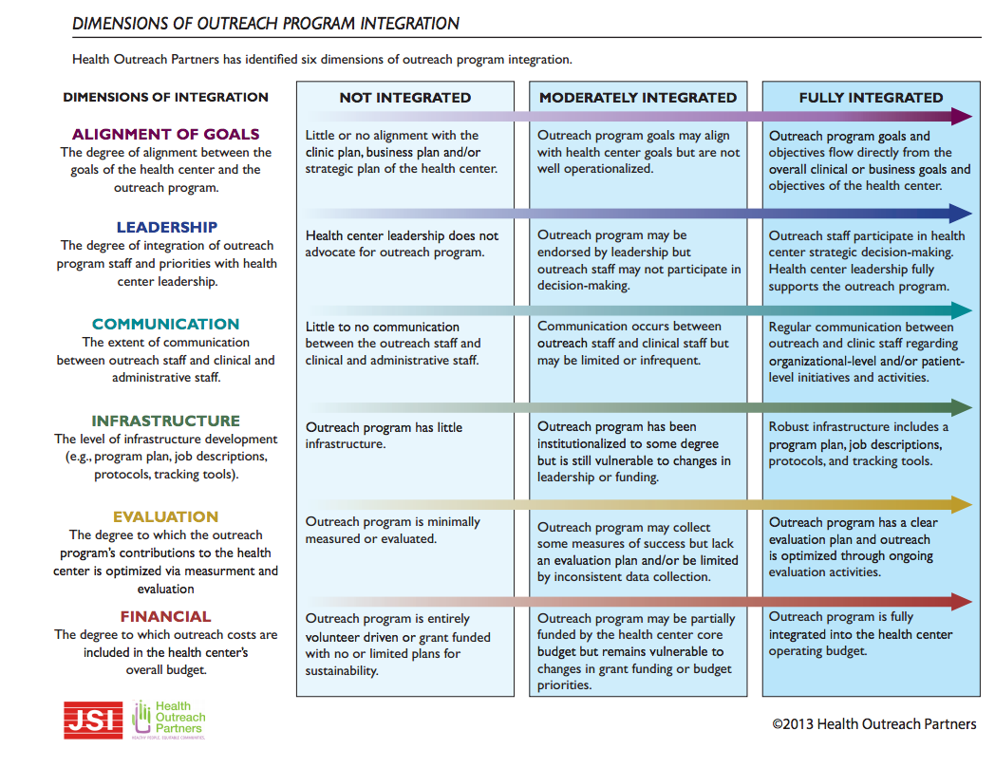

Slide 59





Collective Impact
Common agenda
Establishes shared measurement
Fosters mutually reinforcing activities
Encourages Communication
Strong Foundation
Source: https://www.collectiveimpactforum.org/what-collective-impact

Slide 60

Key Takeaways
CHWs play a vital role in reaching isolated populations, addressing transportation barriers, and linking patients to care and social services.
There is no one way is correct to conduct outreach. You as the outreach staff are a trusted messenger and person in your community
Collaborative Relationships provide the opportunity for organizations to work together towards a common goal or purpose
CHWs improve health outcomes, especially in rural communities or communities managing chronic illness, where access and trust are key challenges.

Slide 61



THANK YOU!
Smruti Shah
Smruti@outreach-partners.org
Jing Murray, MPH
Jing@outreach-partners.org
Health Outreach Partners
@healthoutreachpartners
Health Outreach Partners

Slide 62
Resources
Outreach and Enrollment Curriculum: https://outreach-partners.org/2024/11/outreach-enrollment-curriculum-2-0/
PREPARE Toolkit: https://prapare.org/prapare-toolkit/
https://findhelp.org/
https://www.collectiveimpactforum.org/what-collective-impact
Comptroller Report: https://www.osc.ny.gov/files/reports/pdf/challenges-faced-by-rural-new-york.pdf
OBV Framework: https://outreach-partners.org/wp-content/uploads/2022/11/OBV-Strategic-Framework-.pdf

