Slide 1



Leveraging Data and Turnover Tools to Address Workforce Challenges
January 9, 2025 | 2 PM ET
This project is supported by the Health Resources and Services Administration (HRSA) of the U.S. Department of Health and Human Services (HHS) as part of an award totaling $550,000 with 0 percentage financed with non-governmental sources. The contents are those of the author(s) and do not necessarily represent the official views of, nor an endorsement, by HRSA, HHS, or the U.S. Government. For more information, please visit HRSA.gov

Slide 2


YOUR SPEAKERS
SYDNEY AXELROD
MA
(she/her)
Associate Director of Workforce Development
saxelrod@clinicians.org
Dr. Michelle Fernández gabilondo
DSW, MSW
(she/her/ella)
Director of Workforce Development
mfernandez@clinicians.org

Slide 3

ASSOCIATION OF CLINICIANS FOR THE UNDERSERVED
Access to Care & Clinician Support
National Health Service Corps
Resources
Training
Networking
Recruitment & Retention

Slide 4
STAR² CENTER
National Cooperative Agreement awarded in 2014
Funded by the Bureau of Primary Healthcare
One of 22 National Training and Technical Assistance Partners (NTTAPs)
Produces FREE Resources, Training, and Technical Assistance
www.chcworkforce.org
Contact us: info@chcworkforce.org

Slide 5

INVEST IN THE WORKFORCE
  Turnover is EXPENSIVE!
  *Calculate your health center’s turnover costs by using the STAR² Center Financial Assessment for Provider Turnover Tool (newly updated!)
  As leaders, ask yourselves:
    What’s the actual cost of turnover?
    What’s the cost of a provider vacancy?
    How much does it cost to recruit?
    How much money is your organization losing to these workforce issues?
    How can you better invest money to retain staff and minimize losses?

Slide 6
TURNOVER STATISTICS
Average cost of turnover is between six- to nine-months of an employee’s salary.
  Highly specialized healthcare professionals can cost as much as 200% of the employee’s yearly salary.
According to the Bureau of Labor Statistics, the U.S. healthcare industry lost more than 500,000 employees each month in 2022.
The average cost of turnover for a staff registered nurse (RN) is $56,300.
  Each percent change in RN turnover will cost or save an average of $262,500 per year.
A survey conducted by CHG Health found that between 2020 and 2022, 8% of the reporting physicians retired, 3% had left clinical work altogether, and 43% had made a career move within the healthcare field.
  Main reason most physicians, 35.2% of respondents, made a career move was for work-life balance.
  Compensation, work flexibility, and location were also factors for turnover.
Sources: www.oracle.com/human-capital-management/cost-employee-turnover-healthcare/; www.healthadministrationdegree.usc.edu/blog/turnover-in-health-care

Slide 7
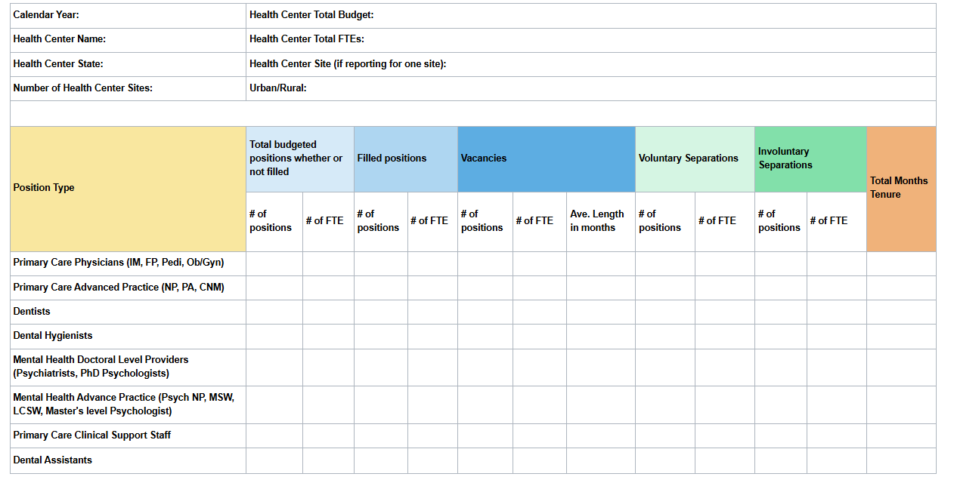


STAR² Center Turnover Calculator Tool

Slide 8
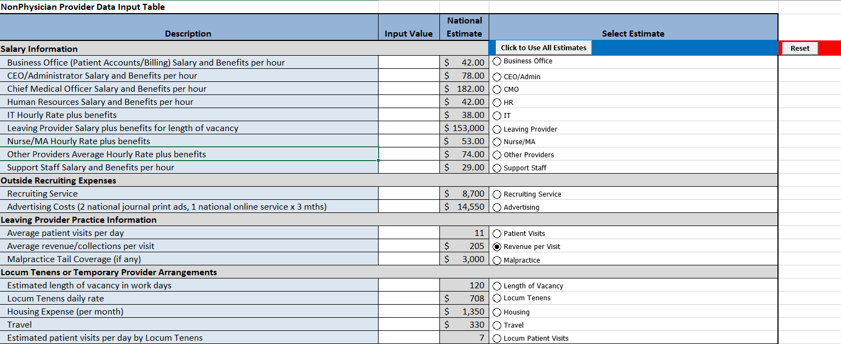
STAR² Center Financial Assessment for Provider Turnover Tool

Slide 9

questions

Slide 10

STAR² Center RESOURCES
You can find all of the STAR² Center’s free resources here
Sign up for our newsletter here for new resources, trainings, and updates
Check out the STAR² Center Self-Paced Courses: chcworkforce.elearning247.com
And the ACU & STAR² Center Video webpage: www.youtube.com/channel/UCZg-CFN7Wuev5qNUWt69u0w/feed
And the STAR² Center Podcast page: www.chcworkforce.org/web_links/star%c2%b2-center-chats-with-workforce-leaders/

Slide 11
STAY IN TOUCH!
Chcworkforce.org
844-ACU-HIRE
info@chcworkforce.org

