Slide 1
Remote Patient Monitoring (RPM) Billing and Reimbursement
Christina R. Quinlan, NETRC Telehealth RCM Strategist
06/12/2025

Slide 2

Housekeeping
Phones have been muted to prevent background noise
Use the chat box to type questions during the webinar
This webinar is being recorded and will soon be available to all participants
A webinar evaluation will be shared with participants

Slide 3



Northeast Telehealth Resource Center
Disclosures and Acknowledgements:
Any information provided by NETRC is for educational purposes only and should not be regarded as legal advice.
Neither NETRC or the presenters have any financial interest, arrangement, or affiliation with any organizations related to telehealth commercial products or services
NETRC is made possible by grant GA5RH37459 from the Federal Office for the Advancement of Telehealth, Health Resources and Services Administration, DHHS.
About Us:
NETRC aims to increase access to quality health care services for rural and medically underserved populations through telehealth. We serve New England and New York, and are a proud member of the National Consortium of Telehealth Resource Centers.

Slide 4
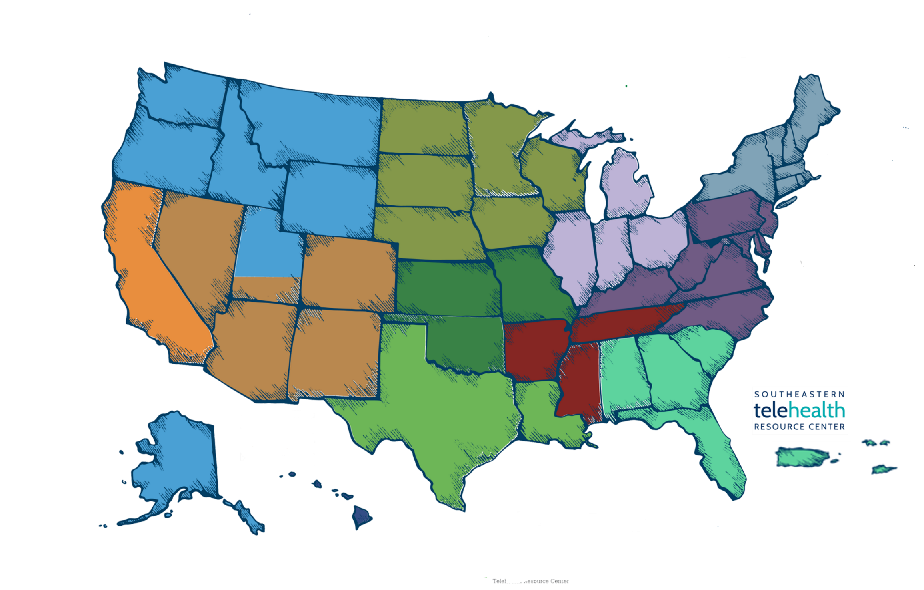



HRSA Funded Telehealth Resource Centers
www.telehealthresourcecenter.org
NRTRC
gpTRAC
NETRC
CTRC
HTRC
UMTRC
SWTRC
SCTRC
MATRC
PBTRC
TexLa
SETRC
^{12 regional Resource Centers}
^{2 national Resource Centers}
^{2 national Resource Centers}

Slide 5


Telehealth Protocols & Workflows
Policy, Legal and Regulatory Factors
Technology Assessment
Business and Strategic Planning
Our Federally Funded Services
Technical Assistance
Education
Business Strategy
We develop educational materials and resources for health systems, providers and patients. Includes: designing/executing needs assessments, identifying funding sources, and assisting with telehealth technology selection are also among our specialties.
We provide expert technical assistance to help build and enhance telehealth programs across the nation. Key focus areas include but are not limited to: telehealth policy, technology, business planning, workflow, etc.
We connect telehealth leaders at local, state, and federal levels to raise awareness and collaboratively produce specialized tools and templates for telehealth programs and providers.
www.NETRC.org

Slide 6

What is RPM?
Remote Patient Monitoring (RPM) involves the use of digital health technologies to collect medical data from individuals in one location and electronically transmit that information securely to healthcare providers in a different location.
Commonly collected data includes:
Blood pressure
Blood glucose levels
Weight
Pulse oximetry (oxygen saturation)
RPM helps reduce emergency room visits, enables early intervention, and enhances the management of chronic diseases.
Notes:
Title Slide Option 2

Slide 7

RPM Reimbursement by Payer Type
Payer | RPM Coverage
Medicare | ✅ Covered — Reimbursed under specific CPT codes.
Medicaid | ❌ Not covered in NYS. CHCANYS is advocating for coverage; DOH has submitted a request to CMS.
Commercial | ⚠️ Varies by plan — Confirm coverage with each payer.
Note: Health centers should confirm RPM reimbursement with each payer and ensure documentation includes patient consent, device usage, and time tracking to meet billing requirements.

Slide 8



CMS FQHC RPM Requirements
Medicare Part B beneficiaries.
Provide consent for services.
Only physicians and non-physician practitioners eligible to provide evaluation and management services can bill RPM services
Have acute or chronic condition(s) for which the authorized billing provider determines that RPM services are medically necessary.
Only one practitioner can bill for RPM per patient in a 30-day period.
Monitoring must be medically reasonable and necessary
You must electronically collect physiologic data and automatically upload it to a secure location where the data can be available for analysis and interpretation by the billing practitioner
The device used to collect and transmit the data must meet the definition of a medical device as defined by the FDA. https://www.fda.gov/medical-devices
Auxiliary personnel can provide RPM services under the general supervision of the billing practitioner
Are considered by CMS to be established patients.
During the COVID-19 Public Health Emergency (PHE), CMS allowed remote patient monitoring (RPM) services to be provided to both new and established patients. Since the end of the PHE on May 11, 2023, CMS has clarified that RPM services are allowed for only established patients. Any patients who received initial RPM services during the COVID-19 PHE are considered by
CMS will be established for patients.
Notes:
Title Slide Option 3

Slide 9
CPT Codes for RPM
CPT/HCPCS Code | Description | Time | Audio-Only Coverage
99091 | Monthly Review of Data | 30 minutes-can be billed again on day 31. | N/A
99453 | Initial setup and monitoring-can only be billed once per patient per condition. | N/A | N/A
99454 | Monthly review of RPM data | 16 or more days over a 30-day period | Yes
99457 | Patient-provider communication related to RPM data | 20-minutes | Yes
99458 | Patient-provider communication related to RPM data | Additional 20-minutes | Yes
Notes:
Title Slide Option 3

Slide 10
Authorized Billing Providers
Physicians:
Medical Doctor (MD)
Doctor of Osteopathic Medicine (DO)
Non-Physician Practitioners:
Nurse Practitioner (NP)
Physician Assistant (PA)
Certified Nurse Midwife (CNM)
RPM services are part of the Evaluation and Management services category, and RPM providers must therefore be qualified to perform and bill for E/M level services.
What they do:
Determine the medical necessity of RPM and order services.
Obtain patient consent for services (verbal or written). If not obtained by the billing provider, consent may also be obtained by auxiliary personnel under the general supervision of the billing provider.
Furnish services personally and/or via general supervision of auxiliary personnel as indicated by the service CPT code
Notes:
Title Slide Option 2

Slide 11
Auxiliary Personnel
Who they are (examples):
Community Health Workers
Nurses (nurse care manager, Clinical Nurse Specialist (CNS), Registered Nurse (RN), Licensed Practical Nurse (LPN))
Medical Assistants
Clinical Pharmacists
What they do:
Obtain patient consent for services (verbal or written)
Set-up equipment
Provide patient education
Continuous monitoring of devices and data collection
Provide RPM Treatment Management Services – collects, reviews, interprets, reports, and manages data under a patient’s treatment plan (may NOT provide RTM Treatment Management Services outside of treatment plan)
Notes:
Title Slide Option 2

Slide 12
CMS FQHC RPM Billing & Reimbursement
CPT Code | Service Elements | Service Provider | FQHC Medicare Billing Code & Rate
99091 | The collection and interpretation of physiologic data (e.g., ECG, blood pressure, glucose monitoring) digitally stored and/or transmitted by the patient and/or caregiver to the physician or other qualified health care professional. The code requires a minimum of 30 minutes of interpretation and review. Note: Do not report 99091 during the same calendar month as 99457, 99458 or on the same day as other E/M services | Authorized billing provider only | CPT 99091: $51.57 or G0511: $54.67 (only valid through September 30th, 2025, for FQHCs transitioning to individual codes)
99453 | Initial device set-up and patient education on equipment use. Note: Medical device as defined by Section 201(h) of the Federal Food, Drug, and Cosmetic Act. Examples: •Blood pressure cuffs •Glucometers •Pulse oximeters •Weight scales •Sleep/activity monitors Billed only once per episode of care. | Authorized billing provider and/or auxiliary personnel under general supervision | CPT 99453: $19.73 or G0511: $54.67 (only valid through September 30th, 2025, for FQHCs transitioning to individual codes)
99454 | The supply and use of device(s) to monitor and record physiological patient data. May be reported once per 30 days and includes scheduled (e.g. daily) recording(s) and/or programmed alert transmissions. Note: Requires at least 16 days of data collection in a 30-day period before it can be billed. Device must automatically upload data; manual logs are not acceptable. | Authorized billing provider and/or auxiliary personnel under general supervision | CPT 99454: $43.02 or G0511: $54.67 (only valid through September 30th, 2025, for FQHCs transitioning to individual codes)
99457 | RPM Treatment Management Services (TMS), clinical staff/ physician/other qualified health care professional time in a calendar month requiring a live interactive communication with the patient/caregiver during the month, first 20 minutes. Note: Includes management of a patient centered treatment plan via interactive communication and via non-face-to-face activities during the 30 days of the service period. | Authorized billing provider and/or auxiliary personnel under general supervision | CPT 99454: $47.87 or G0511: $54.67 (only valid through September 30th, 2025, for FQHCs transitioning to individual codes)
99458 | Each add’tl 20 minutes of RPM TMS | Authorized billing provider and/or auxiliary personnel under general supervision | CPT 99454: $38.49 or G0511: $54.67 (only valid through September 30th, 2025, for FQHCs transitioning to individual codes)
Notes:
Title Slide Option 2

Slide 13
NY Private Payer Reimbursement
Best Practices for Private Payer/Commercial Billing:
Understand Payer/Plan-Specific Polices
  Check online or call Provider-Relations for RPM coverage criteria, such as eligible conditions, patient limitations, and documentation requirements.
  Check for the appropriate use of modifiers and follow payer guidelines. Do they want HD for pregnancy?
  Check for the appropriate place of service (POS). Do they want POS 11 or 50?
  Patient Responsibility
Track time meticulously- Maintain documentation for time-based codes
  Check with your vendor for RPM-specific templates or modules that may assist with time tracking.
Notes:
Title Slide Option 2

Slide 14
Documentation & Compliance Tips
Patient consent and education documented
Device meets CMS standards
Daily data captured for 16+ days/month
Time logs for 99457/99458
HIPAA-compliant data storage & communication
Ensure documentation complies with CMS and private payers
Notes:
Title Slide Option 3

Slide 15
Common Billing Pitfalls
Billing without minimum data collection
Missing time documentation for 99457/99458
Not updating care plans or progress notes
Duplicate billing with RTM (Remote Therapeutic Monitoring)
Using non-FDA approved devices
Notes:
Title Slide Option 3

Slide 16
Opportunities for RPM Expansion
Focus on populations with complex health needs: dual eligibles, seniors, diabetics
Use RPM for transitions of care (post-discharge monitoring)
Align with value-based care metrics
Partner with MCOs for coverage clarity and support
Notes:
Title Slide Option 3

Slide 17
Resources:
CMS MLN Telehealth & Remote Patient Monitoring | https://www.cms.gov/files/document/mln901705-telehealth-remote-patient-monitoring.pdf
NACHC RPM Reimbursement Tips | https://www.nachc.org/wp-content/uploads/2024/04/RPM_RTM-Reimbursement-Tips.pdf
CMS FQHC | https://www.cms.gov/medicare/payment/prospective-payment-systems/federally-qualified-health-centers-fqhc-center
NGS Medicare | https://www.ngsmedicare.com/remote-monitoring-services?lob=93619&state=97300&rgion=93623&selectedArticleId=4521902
Anthem | https://providernews.anthem.com/new-york/articles/reimbursement-policy-update-virtual-visits-professional-and-8-18862
Cigna | https://static.cigna.com/assets/chcp/pdf/coveragePolicies/medical/mm_0563_coveragepositioncriteria_remote_patient_monitoring_and_remote_therapeutic_monitoring.pdf
Emblem Health | https://www.emblemhealth.com/content/dam/emblemhealth/pdfs/provider/reimbursement-policies/telehealth-virtual-care-services-reimbursement-policy-emblemhealth.pdf
Notes:
Title Slide Option 2

Slide 18

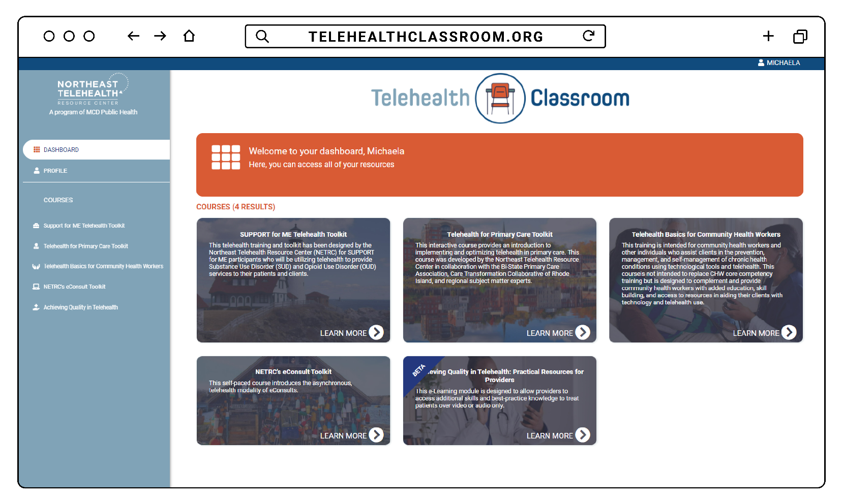
www.TelehealthClassroom.org
Telehealth Classroom is an open-access eLearning Portal developed by the federally funded Northeast Telehealth Resource Center
Courses available include:
  Achieving Quality in Telehealth
  Telehealth Basics for Community Health Workers

Slide 19


Questions?

Slide 20

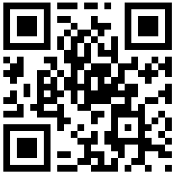
Thank You!
www.NETRC.org
800-379-2021
Join our newsletter!

Slide 21

Please fill out our survey!
Please find the survey link in the chat. You will also receive it in a follow-up email along with this slide deck.
Completing your survey helps us to provide relevant and helpful information. Thank you in advance!

