Slide 1



Aligning Patient Values & TeleSUDs: Transforming Prenatal Care Through Innovation & Access to Care
April 8th, 2025, 12:00pm
Portions of this initiative are supported by the Health Resources and Services Administration (HRSA) of the U.S. Department of Health and Human Services (HHS) as part of an award to CHCANYS’ New York State Primary Care Association (NYS-PCA) totaling $1,932,890. The contents are those of the author(s) and do not necessarily represent the official views of, nor an endorsement, by HRSA, HHS, or the U.S. Government. For more information, please visit HRSA.gov.
Notes:
Title Slide Option 2

Slide 2

Housekeeping
Welcome!
Let’s get to know each other - Take a moment to introduce yourself in the chat!
Phones have been muted to prevent background noise.
Use the chat box to type questions during the webinar!
Your feedback is welcome! – Please complete the webinar evaluation shared with participants at the end of the session!

Slide 3
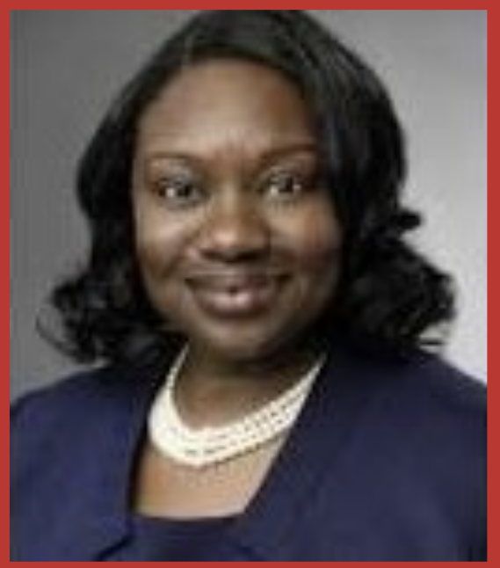

Our Presenters
Davina Moss, Ph.D., CRC, CASAC
Positive Direction and Associates, Inc.
Katrina Garrigan, PA,
Director of Behavioral Health Services
East Hill Medical Center

Slide 4


Aligning Patient Values & TeleSUDs: Transforming Prenatal Care Through Innovation & Access to Care
Dr. Davina A. Moss, PhD, CRC, CASAC
Positive Direction and Associates, Inc.®
The Positive Direction Model®
April 8, 2025

Slide 5
Disclaimer
Dr. Moss will not benefit financially from mentioning or teaching about medications associated with Medication Assisted Treatment, medications associated with breastfeeding, infant formula or mental health treatment.

Slide 6
Acknowledgements
Community Health Care Association of New York State
Community Health Care Association of New York State

Slide 7
Objective
Illustrate how identifying values help pregnant women with SUD fully engage with prenatal care, begin to build a healthier lifestyle and move toward the action stage of change in recovery parenting
Utilizing TeleSUDs to engage in prenatal care early and often improving the appointment rates

Slide 8
Goal
Understand the significance of values to increase self-worth, enhance decision making and invest in the family’s quality of health .

Slide 9
Reasons for lack of / no Prenatal Care
Fear punishment for using illegal substances
Fear of being judged
Lack of transportation
Lack of insurance
Resources to connect with a provider
Guilt / Low Self-Worth
Connection ranges between end of 1st Trimester to the end of the 2nd Trimester
Uses the Emergency Department as a prenatal care hub

Slide 10
Research: Prenatal Care Connection
Simmons & Austin (2022)
Stone (2015)
Illicit Drug use : 3.3-4.1 months
Opioid Use: 2.9-3.2 months
Marijuana Use: 3.0-3.3 months
Simmons, E. & Austin, A.E. (2022). Association of prenatal substance use with prenatal and postpartum care: Evidence from the pregnancy risk assessment monitoring system, 2016-2019. Prev Med. 2022 June: 159: 107065. DOI:10.1016/j.ypmed.2022.107065.
Fear of Detection
Social Isolation and Denial of Pregnancy
Avoidance of medical care
Stone, R. (2015). Pregnant women and substance use: fear, sigma, and barriers to care. Health & Justice Journal 3: 2 DOI 10.1186/s40352-015-0015-5.

Slide 11
Self-Worth
Self-worth is the internal sense of being good enough and worthy of love and belonging from others
Self-worth is an internal sense of self-value and self-worthiness. It's a fundamental part of who we are, and it impacts how we think, feel, and behave.

Slide 12
Values
Values are basic and fundamental beliefs
Values describe the personal qualities
Values are the motive behind purposeful behavior

Slide 13
Schwartz (1992, 2012) Defines Values
Beliefs
Refers to desirable goals
Transcend specific actions and situations
Serve as standards / criteria
Ordered by Importance
Guides Actions
Schwartz, S. H. (2012). An overview of the Schwartz theory of Basic values. Online Readings in Psychology and Culture, 2(1).

Slide 14
Motivational Interviewing Value Card Sort
W.R. Miller, J. C'de Baca, D.B. Matthews, and P.L. Wilbourne developed the value card sort in 2001.
Identify the core belief
Understand the aligning between the core value and the behavior

Slide 16
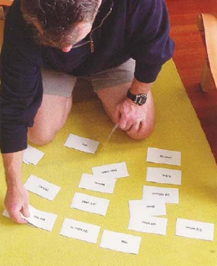
Motivational Interviewing – The Card Sort
Card Sort : ability to do during sessions within the family / couples / individually / along with a caretaker that will be involved with the mom through out the pregnancy process.
The Personal Values Card Sort, a tool used in Motivational Interviewing, helps individuals identify and clarify their core values by sorting cards into categories based on importance, ultimately leading to a deeper understanding of oneself and one's priorities.

Slide 17
Positive Direction Model®
Values
Virtual Meetings
(12 Sessions)
Purpose(s)
Engage and educate mothers while assisting them to navigate the health care system during pregnancy.
Discover values that motivate behavior resulting in quality of health improvements
Develop goals in relationship to the prioritized values

Slide 18
Steps for the provider
Trusting conversation regarding what is most important [value(s)]
Discuss the alignment of the behavior and priorities
Refer to the values at each visit (virtual or in-person)

Slide 19
Outcomes
Engaged in the Navigator Sessions
The patient continues with her recovery via TeleSUDs
Engaged in the Obstetrician Appointments
Motivation toward change
  Improving nutrition
  Positive Self-Talk
  Elevated Self-Worth
  Improved attendance (Obstetrician)

Slide 20
The Positive Direction Model® Outreach
FLIPA Organizations with Uconnect Care – 2023 to Present
SUNY @ Buffalo Jacobs School Of Medicine And Biomedical Sciences– 2023 to Present
Uconnect Care – 2020 to Present
Erie County – 2017 to present
Chautauqua County – 2016 to 2019
University of Arizona – 2014-2015
NYS Stutzman Facility – 2014- Present
Catholic Health Home and Community Based Care 2014-2018
Highmark of WNY (WellPoint)
Monroe Plan
Opioid Settlement Funds (Erie County)
Outcomes
87 Infants born
6 extended stay in the NICU
Mothers connected with TeleSUDS
Mothers enjoyed the autonomy

Slide 21
Summary
Pregnant mothers benefit from virtual appointments to improve the connection with their provider
Prioritizing values improves the decision making of the pregnant woman
Discovering values improves the pregnant woman’s self worth and motivation to take action steps toward change

Slide 22


Thank you
Davina Moss, PhD, CRC, CASAC
50 Fountain Plaza
Suite 1400
Buffalo, NY 14202
(716) 704-5510
http://www.pdawny.com
Davina.Moss@pdawny.com

Slide 23



Integrated Models of Care: TeleSUDs Screening & Treatment

Slide 24
No financial issues to disclose
Katrina Garrigan, PA-C
  Director Behavioral Health, Physician Assistant
  East Hill Medical Center and East Hill Inner Wellness
  kgarrigan@easthillmedical.com

Slide 25

Integrated Care/Team Approach
Many OB providers are not comfortable managing behavioral health or SUD meds – we prioritize these referrals
-Collaboration with Nicks Ride 4 Friends
-Social risk screens at every in person visit
-Care Navigators who meet with patients that have positive screen to review resources within the community. Training in Positive Direction Model to provide support to pregnant patients
-Healthy Steps Specialist embedded at our pediatric office.

Slide 26
Patients with SUD should be able to access evidence based, compassionate care at any interaction with a health care provider
Feeling hopeless can reduce the willingness of individuals with SUD to disclose their use and therefore miss the opportunity for treatment. Feelings of shame and isolation may in turn reinforce drug seeking behavior
-1st visit - in person – scales, physical exam, urine drug screen – transportation: MAS, Bus, Uber, Peer Support
-prefer 1st follow up in person if initiating Subutex for dose adjustments
-follow up can be virtual or even by phone if needed for transportation barriers

Slide 27
Barriers
- We utilize language lines and make every effort to meet patients where they are at in their journey, provide judgment free care, emphasize education to patients
Support: Provide harm reduction tools: drug test strips, Narcan kits, education to family on signs of intoxication and crisis lines
-SAMHSA offers free education/trainings to providers through the Provider Clinical Support System, PCSS. Accessible on their website
Billing: typical E&M codes, telehealth codes, supportive psychotherapy codes

Slide 28

Limitations to Data Collection
Pulling reports from multiple software systems - Medent, Azara, UDS
Listing Pregnancy as a Diagnosis – primary care vs. behavioral health dept relevance
Listing the SUD dx in the note
Utilizing “characteristics” within the EMR

Slide 29
Thank you
East Hill Medical Center
315-253-8477
www.easthillmedical.com

Slide 30

Please fill out our survey!
Find the survey link in the chat and again at the close of the webinar.
Completing your survey helps us to provide relevant and helpful information. Thank you in advance!

Slide 31



